Slide 1
Integrated Care Fund Challenge Session
Domiciliary Rapid Response Service

Slide 2
Project Introduction
The Rapid Response Service supports Frail adults with sudden and / or unexplained functional decline to minimise escalation of need. The Service enables people to remain at home, prevents hospital admission, and supports timely transitions from hospital to home, thereby enhancing recovery and reducing further dependency.
The Service is managed and delivered by the Local Authority’s In House Domiciliary Care and Support Team. The Agency is Registered with the Care Inspectorate (Wales) and Inspected under the Care Standards Act 2000.
Domiciliary Supervisors and Senior Support Workers attached within Office Hours and during Out of Office Hours 6.45 am – 10pm x 7 Days a week.
The Team consists of 24 part time staff working 26.25hr contracts – 630 contract hours per week. Covering shifts 7 – 3 and 2 – 10. Currently based at 2 Extra Care Locations.
12 staff covering Llanelli/A & G and Towy and 12 staff covering Teifi, Taf & Gwendraeth – 3 staff members in both locations during both shifts.
4 x 4 Vehicles attached to each team and Manga Lifting Camels x 2.

Slide 3
Funding arrangements
Funding arrangements:
Budget:
Funding from ICF: | 2017 – 2018 £488K
Any other funding: | nil
Spend 2016/17 (incl spend to date): | £469K
Projected 2018/19 budget required: | £500K
Andrea Thomas - Resources

Slide 4
Project tie-in with ICF objectives
Supports the provision of care and support closer to home during times of critical / acute non medical interventions.
Liaises and negotiates with other Community based services to reduce admissions into hospital, and facilitate the transfer and continuity of high quality care and support.
Supports patients requiring short term support to enable discharge from hospital, bridging the gap until longer term services are available to commence.
Supports individuals with chronic conditions or palliative care needs as their situation fluctuates over time.

Slide 5
In House Domiciliary Business

Slide 6
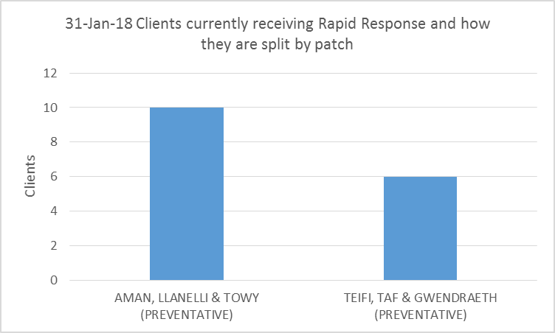
Projects key achievements:

Slide 7
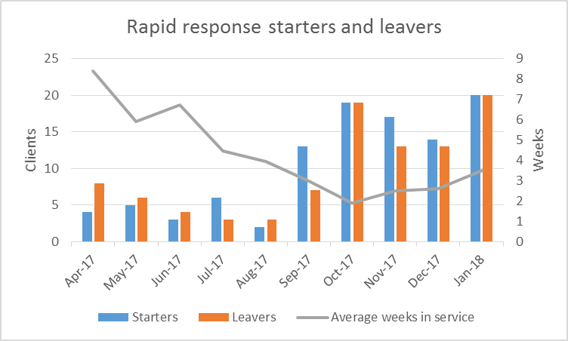
Activity:

Slide 8
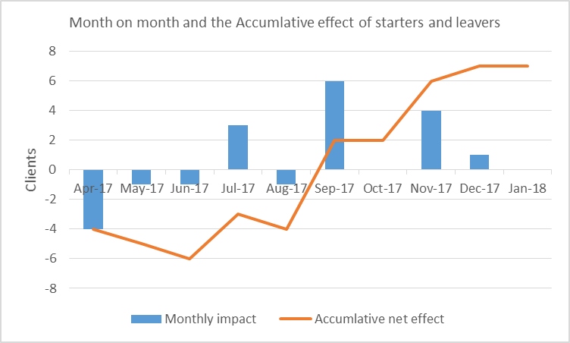
Looking in more detail at the variation of starters and leavers, during the months it appears we had a drop in demand April to Aug, then we see an increase from Sept to Jan.
Drop in demand
Rapid response cover Reablement / Longterm

Slide 9
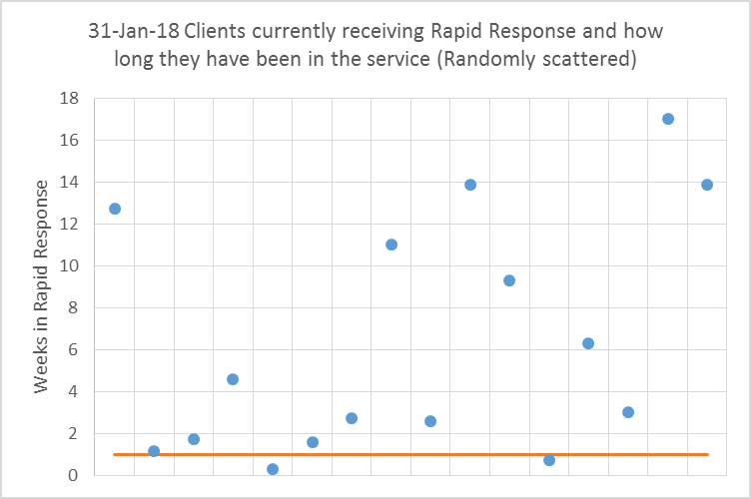
The Scatter Graph – Visual representation of our Clients

Slide 10
Key case study / studies
Mr B an 80year old gentlemen living with his wife. Currently receiving no services , with a history of falls. Mr B recently fell on three consecutive occasions within a short period of time
DN visited to undertake a falls assessment following 2 referrals from WAST.
Mr B presented as very poorly, GP advised hospital admission which Mr B declined preferring to remain at home with his wife, regardless of his prognosis. Mr B was dehydrated and currently being cared for from his bed.
Mr B has suspected kidney failure – this is something he had previously experienced from which he had recovered.

Slide 11
Key case study / studies Cont.
Mrs B was unable to meet his needs and was reliant on the goodwill of neighbours to assist with transfers etc. The DN felt that an urgent DST (Decision Support Tool) needed to be undertaken however in the meantime most importantly support at home was needed immediately pending a decision for CHC (Continuing Health Care). Mr B to be fast tracked for Continuing Health Care, also awaiting the delivery of a hospital bed. GP completed a ‘Do Not Resuscitate ‘form as per Mr B wishes.
No CHC services available.
Urgent referral made for Rapid Response by DN for two staff to attend. RR supported for a period of four days, after which a hand over to the CHC team took place.
The RR team were able to successfully ‘bridge the gap’ between services thus enabling to meet Mr & Mrs B wishes to remain at home with support.

Slide 12
Sustainability plan
Continued Funding is necessary :
Implications if Rapid Response did not continue:
Delayed Transfers of Care will increase further
Longer stays in hospital for people who are considered functionally stable and ready to be discharged.
People in the Community will be left with no support / options other than to be ‘pushed’ into hospital ie: admissions by GP’s as the capacity for response to unscheduled care needs in the community is limited.

Slide 13
Project development
Broker – Co-ordinator
Implementation / Clear Service Specification
Change Location PP/GGH – Short term Teams CRT’s
Frailty /Front Door Hospital – Project
TOCALS – PPH Project
ART
Closer Working OT’s & Physio’s / Therapy Support Workers /Frailty Nurses

Slide 14
Conclusion
Need Co-ordinated Approach - Robust Intermediate Care Pathway
Intermediate Care
Home from Hospital & 3rd Sector
Domiciliary Reablement
Discharge to Assess Bed
Rapid Response
Rehab Support Programme
Convalescence Bed
Community Hospital Bed
Step up/down Bed (including Extra Care)
Acute Response Team
Rapid Access Frailty Service

