Slide 1


West Wales Care Partnership (WWCP)
Dementia Strategy
February 2022
V19_0DRAFT

Slide 2
Contents
Page | Detail
3 | 1. Background
7 | 2. Population Needs Analysis Summary
11 | 3. Current Action Plans, Regional Transformation Projects
15 | 4. What Does Best Practice Tell Us?
22 | 5. Feedback From Structured Interviews
26 | 6. West Wales Dementia Service Vision and Wellbeing Pathway
39 | 7. Our Approach To Implementing The Dementia Wellbeing Pathway
51 | 8. Next steps for 2022/23
53 | 9. Appendix 1: West Wales Population Analysis
60 | 10. Appendix 2: Feedback From Initial Structured Interviews
64 | 11. Appendix 3: Approach to managing the programme of work

Slide 3
1. Background

Slide 4







Background
The West Wales Care Partnership (WWCP) brings together organisations from the statutory, third and independent sectors with a remit of integrating and transforming health, care and support in the region.
A statutory Regional Partnership Board oversees the work of the WWCP.
A regional Dementia Steering Group sits underneath the RPB and comprises representation from across the Partnership. It provides a mechanism for developing a regional approach to caring for people living with dementia (PLWD) and their families. This Group worked closely with Attain in developing the draft Strategy and will have a key role in taking forward implementation of the next phases of work.
Welsh Government provides funding through the Integrated Care Fund (ICF) to support the improvement of care and support for PLWD and their families, This funding is managed through the Dementia Steering Group and will be instrumental in delivering agreed priorities within the Strategy.
Key partners on the WWCP are:
  Hywel Dda University Health Board
  Carmarthenshire Association of Voluntary Services
  Pembrokeshire Association of Voluntary Services
  Ceredigion Association of Voluntary Organisations
  Pembrokeshire County Council
  Carmarthenshire County Council
  Ceredigion County Council

Slide 5
Background
In February 2021, the WWCP appointed Attain to work with partners to develop a regional dementia strategy and service model pathway of care. Alongside this work, we carried out a review of the regional ICF dementia projects which provided a steer as to what services should continue to be funded, as well as an indication of any additional initiatives that should be undertaken during 2021/22. One priority area was for Attain to develop a business case for the introduction of a dementia wellbeing connector which is based on best practice and an intrinsic role within the WW Dementia Wellbeing Pathway.
The context for this work includes:
Increasing focus worldwide on dementia and its impact on health and social care systems; prevalence is increasing year on year, mainly due to people living longer, particularly in high income economies.
To clarify its dementia strategy, In February 2018, the Welsh government published the ‘Dementia Action Plan 2018-2022’.
The vision is for Wales to be a ‘dementia friendly nation that recognises the rights of people with dementia to feel valued and to live as independently as possible in their communities’.
In March 2021, Improvement Cymru published the All-Wales Dementia Care Pathway of Standards. This work, directed by the requirements of the Dementia Action Plan for Wales, is overseen by the Welsh Government Dementia Oversight Implementation and Impact Group (DOIIG).
The twenty standards have been designed to be dynamic by responding to evaluation and supporting evidence. They sit within four themes: Accessible, Responsive, Journey, Partnerships and Relationships Underpinned by Kindness and Understanding.
The standards have been developed using the Improvement Cymru Delivery Framework and it is anticipated that work will focus on developing a two-year Delivery Framework Guide for the Welsh regions covering the period April 2021 – March 2023.
Prior to the implementation of the Framework, Attain has co-designed this strategy with colleagues, people living with dementia and their carers across West Wales. The high-level strategy also provides a programme governance structure and the foundation on which to fund services which is in line with the Improvement Cymru Delivery Framework.

Slide 6
Project requirements and activities
This slide outlines the project requirements, the outcomes from the work undertaken and key actions.
The Ask:
Attain have:
Key Recommendations
Overarching Dementia Strategy and Delivery Plan
Facilitate co-production of a regional dementia strategy with stakeholders, PLWD and their carers
Develop a sustainable model and associated delivery plan for the strategy in the medium to longer term, deployment of existing and future funding streams to support this and accounting to Welsh Government and other stakeholders on delivery and impact
Consider future regional programme ownership and leadership requirements to implement and deliver the dementia strategy
The dementia strategy and associated delivery plan needs to be considered in the context of changing demographics across the region, the long-term impact of COVID-19 on people with dementia and evidenced impact of existing workstreams
2. Development of a business case for the dementia case manager role
In line with All Wales dementia standards and the Health Board’s recently developed palliative and end of life care strategy, develop a business case for the dementia case manager role
3. In respect of the above tasks, Attain have been required to:
Work with a range of national and regional stakeholders, including Welsh Government officials, system leaders, service managers, clinicians and practitioners, elected and independent members and users and carers as appropriate
Produce high quality proposals and reports to a range of audiences
1. Overarching Dementia Strategy and Delivery Plan:
Produced a report following a review of national and international best practice
Worked with colleagues to develop a regional strategy, vision and service model pathway based on best practice
This strategy includes a proposed programme and governance structure which fits with the Welsh Government and Regional structures
The strategy includes a summary of current and future population demand and prevalence. Information relating to the impact of COVID-19 upon those with dementia is not available at this stage
Stakeholders have identified that COVID-19 has impacted timely diagnosis due to late presentations and inability to access assessment services
2. Development of a business case for the dementia wellbeing connector role:
Carried out a desktop review on best practice in dementia case co-ordination/management and average case load level
Developed a business case with input from the WWCP dementia steering group members
3. Stakeholder engagement:
Attain have worked with multiple stakeholders across the region people living with dementia (PLWD) and their carers and front line staff. All West Wales Care Partners have been fully engaged and very supportive in the development of this strategy
1. Implementation of strategy and dementia wellbeing pathway
Once the strategy is formally approved by the WWCP, socialise the recommendations of the strategy, and the dementia wellbeing pathway to ensure that it is owned by colleagues, PLWD and their carers across West Wales
A communication plan should be developed to run for the life of the strategy
WWCP to adopt the proposed governance structure and recruit a Regional Dementia programme manager
A full business case should be developed to take forward the establishment of the dementia wellbeing connector role
The strategy, vision and service model pathway should be reviewed once information is available regarding the impact of COVID-19 upon those with dementia and their carers
The waiting time for diagnosis should be reviewed and monitored; solutions should be found to address long waiting times, including the codesign and development of the regional dementia diagnosis pathway
2. ICF Dementia Plan:
The strategy recommends that a review be undertaken of ALL initiatives currently funded by the ICF, including evidencing outcomes, align funding to implement the strategic priorities, and ensure any new way of working is fully resourced
Develop a regional strategic and co-ordinated approach to supporting carers – consider top slicing the dementia ICF funding to enhance the carers’ element so ensuring continuation of services, supporting those who are caring for people living with dementia

Slide 7
2. Population needs analysis
For more information on the population analysis please see appendix 1

Slide 8
Population projection of those with dementia in West Wales
1 in 6
Alzheimer's Society UK estimates dementia affects one in six people aged 80+. West Wales records show 1 in 10 people over 85 with dementia.
Alzheimer's Research estimates that the diagnosis rate* is 53% across Wales, suggesting a current unmet need across Hywel Dda of 2,400 patients
The table below shows ALL diagnoses of dementia on the West Wales GP register forecasted forward, factoring in the increase in over 85s and an estimate of undiagnosed need. Data on waiting lists was not available but it is important to find ways to monitor this as demand increases.
County | Current diagnosed (on GP register) | Current estimated undiagnosed | Current estimated total prevalence | 2040 projected diagnosed** (based on current diagnosis rate) | 2040 projected undiagnosed** | 2040 projected total prevalence
Carmarthenshire | 1,363 | 1,208 | 2.571 | 2,035 | 1,793 | 3,828
Ceredigion | 578 | 512 | 1,090 | 863 | 760 | 1,623
Pembrokeshire | 871 | 772 | 1,643 | 1,300 | 1,145 | 2,445
West Wales | 2,812 | 2,492 | 5,304 | 4,198 | 3,698 | 7,896
7,896 by 2040 (inc. undiagnosed need)
To put this into perspective…
This is equivalent to everyone in Pembroke living with dementia.
*The diagnosis rate is the diagnosis percentage compared to the estimated actual prevalence
** projection is based on the diagnosis rate remaining the same as current, this is a strictly ‘Do Nothing’ scenario

Slide 9
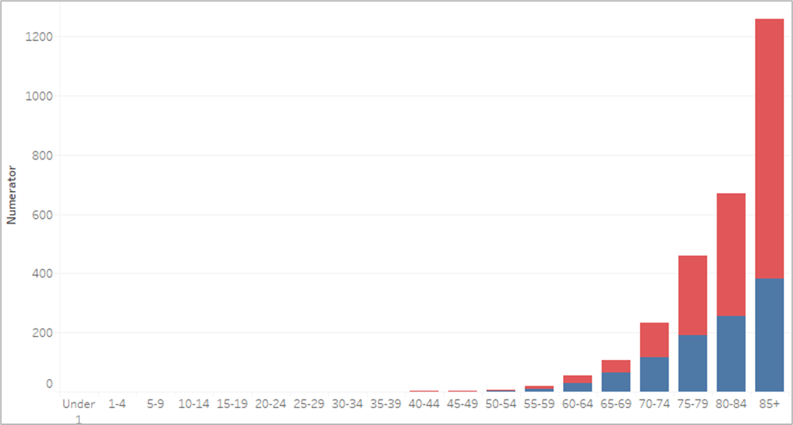
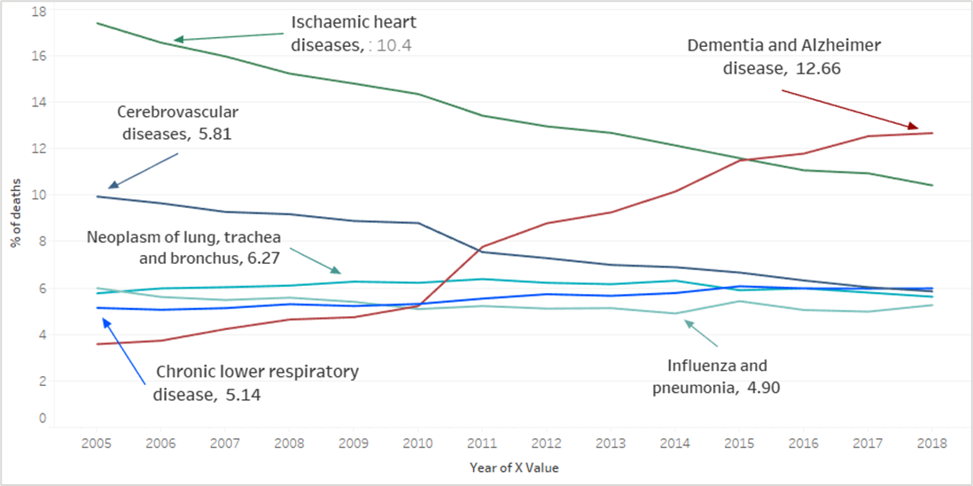
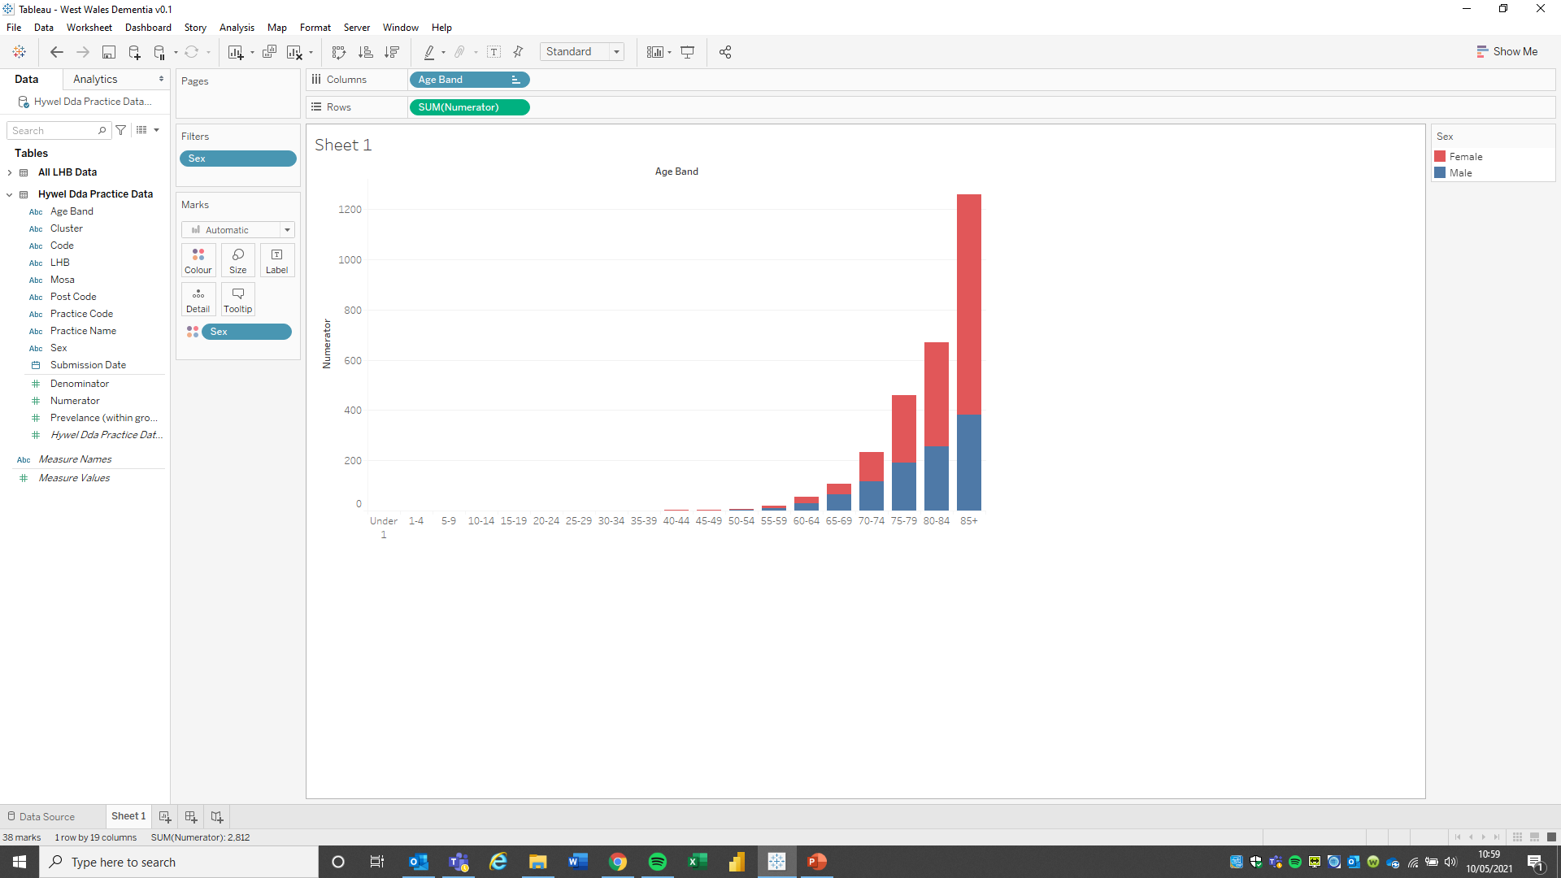
Dementia Diagnosis West Wales
Predominantly (62%) female due in part to longer life expectancy of women
65% of dementia patients in UK are women and they also make up over 60% of carers
45% of patients are over 85 years old and this population will grow across Hywel Dda
Leading cause of death in the UK (pre-COVID-19) and represents 12.7% of all deaths
Diagnosis prevalence across Ceredigion is highest: 0.8% of total list
Ceredigion has the highest proportion of over 65s at 26%; the average for Hywel Dda is 25%
56% of young onset* diagnosis are male (24 are in Carms and 10 in Ceredigion)
*Young onset dementia is the onset of dementia when a person is under 65 years old. Across West Wales there are 84 patients on the registers who are under 65 years old. Of those, 55 are in the 60-65 year age group. This gives West Wales a rate of 0.04% across the population in the adult population, which is very similar to the rate seen across Wales registers nationally.
The population of Hywel Dda is ageing, over 10% will be over 85 by 2040
Adult population is reducing across all areas, in particular in Ceredigion
(-11% 2040)
Decreasing adult population reduces supportive care for the older population
84 patients on the register with young onset dementia (0.06% of adults)
Patients on GP registers with a dementia diagnosis West Wales
Leading causes of mortality, UK up to 2018 (showing most recent % of total deaths)

Slide 10
3. Current action plans, regional transformation projects​

Slide 11

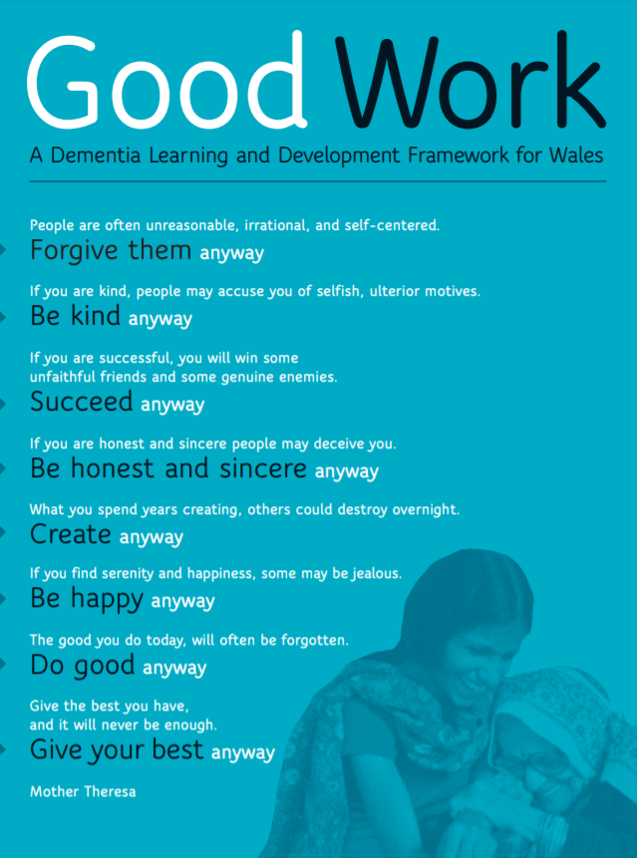
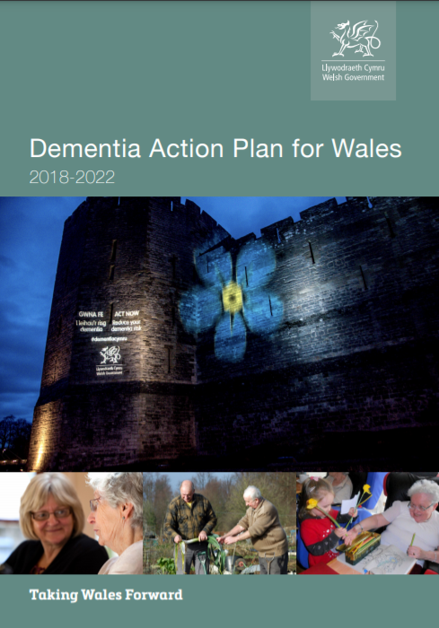

Relevant dementia documents for Wales:
This strategy and the future palliative & EoLC programme will draw on key existing initiatives:
Ageing Well in Wales
Good Work Framework A Dementia Learning and Development Framework for Wales
All Wales dementia action plan
All-Wales Dementia Care Pathway of Standards
Launched in 2014 Ageing in Wales: An overview in a European perspective
5 Priority areas to Improve the health and well-being of older people in Wales :
Age friendly communities
Dementia supportive communities
Falls prevention
Loneliness and isolation
Opportunities for learning and employment
Appropriate accommodation for older people can help to contribute to addressing all of the above.
In February 2018 the Welsh government published the ‘Dementia Action Plan 2018-2022’
The Action Plan sets out a clear strategy for Wales to be a ‘dementia friendly nation that recognises the rights of people living with dementia to feel valued and to live as independently as possible in their communities’.
In March 2021, Improvement Cymru published the All-Wales Dementia Care Pathway of Standards. This work, directed by the requirements of the Dementia Action Plan for Wales, is overseen by the Welsh Government Dementia Oversight Implementation and Impact Group (DOIIG).
20 standards have been designed to be dynamic by responding to evaluation and supporting evidence. They sit within four themes: Accessible, Responsive, Journey, Partnerships and Relationships Underpinned by Kindness and Understanding.
The standards have been developed using the Improvement Cymru Delivery Framework and the work will focus on developing a two-year Delivery Framework Guide for the regions across Wales covering the period April 2021 – March 2023.
Published in 2016 Overall, the aim of the Framework is to support people to freely, creatively and responsibly identify and address their own specific learning and development needs within the context of their lives and circumstances, wherever they happen to be. The intention of the Framework is not to constrain people by providing an overly prescriptive list of who needs to know and do what.
This Framework is intended to support what matters most to the people of Wales, as well as the spirit and requirements of Welsh policy, legislation and guidance regarding the care, support and empowerment of people with dementia, carers and the health and social care workforce.

Slide 12
EoLC Health Board dementia specific provision - West Wales area
The HDuHB Together for Health End of Life and Palliative Care Delivery Plan 2016 -2020 outlines the
current EoLC resources available to support people with dementia:
Source: HDuHB Together for Health End of Life & Palliative Care Delivery Plan 2016 -2020
Current Services:
Areas for improvement:
Using Welsh Government funding which was facilitated by West Wales Care Partnership, HDUHB commissioned Paul Sartori and Marie Curie to deliver training on Advance Care Planning and Dementia
Marie Curie Senior Nurses help patients with advanced dementia access palliative and end of life care services across the region. The nurses support multi-disciplinary teams to meet the care needs of people with dementia in hospital, at home and in care homes. They also aid the safe transfer of care across care settings.
Paul Sartori Foundation also provide education to a variety of audiences, both to their own staff but also to others across the Health Board, including topics such as dementia.
In Pembrokeshire various members of the team have also contributed to other educational events, including teaching about Advance Care Planning at a dementia conference.
More work is needed on early detection of those living with dementia and to provide the support required. This will include education for colleagues within primary care to consider when someone with dementia is approaching their end of life and support to include this group within palliative care registers.
Improve early detection and care of frail people accessing services, including those with dementia, specifically aimed at maintaining wellbeing and independence.
Recognise the need to give particular focus to the experience of specific groups including those who have learning disabilities, dementia, hearing or sight problems and those who are elderly and frail. Carers are a particular group of people who often go unrecognised.
In addition to the development of the Long-Term Care Patient Pathway, each Long-Term Care Specialist Nurse is developing a special interest in a particular area of expertise; these areas include pain management, end of life care, dementia care, nutrition, medication management and other aspects of fundamental care. These skills will be utilised to support safe and person-centred care delivery.
While services are in place in West Wales, implementing the priorities from the Welsh Dementia Action plan have been included in the palliative and EoLC programme plan and will have significant impact on the quality of EoLC services for those with dementia.

Slide 13
4. What does best practice tell us?

Slide 14
Dementia – key areas of focus
The review of national and international best practice and innovation in dementia, identified many areas of best practice, research and innovation across the whole dementia care spectrum.
Dementia is a condition that cuts across system wide services and is therefore everyone’s business. It is important to understand to recognise that dementia services need to be embedded in the whole system of provision.
This strategy focuses on key areas to drive improvement and innovation across West Wales, namely:
  Implementing strategies to achieve early diagnosis
    Supporting GPs, allied health professionals (AHPs) and nurses to make assessments and improve quality of referrals to specialist services
    Focus on implementing best practice within social care, domiciliary care, care homes and specialist services
  Implementing care pathways, particularly post diagnostic support
    Support and co-ordination for PLWD and their carers
  Supporting carers to care for family members with dementia
    Providing support, training and help to navigate/co-ordinate services to families, build resilience and maintain balance across all aspects of their life
  Improving end of life care so that PLWD die in a place of their choosing with dignity
    Co-ordination amongst different care providers to ensure they understand the end-of-life plan

Slide 15
Early diagnosis – in the community
NICE guidelines suggest assessment and diagnosis take place in non-specialist settings. This backs up international models where diagnosis is made in Primary Care where possible.
GPs, AHPs and nurses can decrease pressure on specialist services through;
  Assessment and diagnosis in primary care
  Improving quality of referrals into specialist care
GPs and colleagues within primary care are also often the first contact for someone living with dementia, but many studies across UK and internationally show a lack of confidence from GPs, AHPs and nurses within primary care to diagnose dementia
Increased training, awareness and new dementia models within primary care can all help towards optimising resource capacity and achieving earlier diagnosis of dementia
Some diagnosis models suggest a 3-tier approach 1) initial assessment in primary care 2) a second assessment/diagnosis by dementia care experts within primary care 3) referral to memory clinics for dementia diagnosis.
Improving Primary Care Assessment/ Diagnosis
Training for GPs, AHPs and nurses aligned with the ‘Good work’ framework and international best practice
Funding/frameworks in place to encourage GPs and AHPs to attend training
Increase confidence of GPs and AHPs to improve dementia diagnosis/quality of referrals to specialist services
Support framework for GPs and AHPs including toolkits, guidelines and regular training
Rapid access to dementia experts in primary care and specialist memory clinics
Primary Care Assessment
Primary Care Dementia Experts
Specialist Care

Slide 16
Early diagnosis
Primary Care Assessment
Primary Care Dementia Experts
Specialist Care
Primary Care
Training for GPs, AHPS and nurses based on the ‘Good Work Framework’ for dementia awareness and to spot early signs of dementia
Training to undertake some testing to identify people who may have dementia
Reduce strain on specialist memory clinics by improving quality of referrals
Remove barriers to GPs and AHPs attending training
Consider delivering training online to improve accessibility
Primary Care Dementia Experts
Identify a cohort of GPs, AHPs and nurses that can act as dementia experts (e.g. GPs, AHPs and nurses with special interest)
Specialist training for dementia experts based on the ‘Good Work Framework’
People identified in primary care could be referred for additional assessment
Access to diagnostic tools
Improve quality of referrals to specialist memory clinics
Memory Clinics
Services commissioned in line with frameworks
Memory Services National Accreditation Service MSNAP
Review of and alignment with best practice from across UK
Improved brain scan protocols
Focus on reducing referral to diagnosis times and managing capacity and demand
Focus on diagnosis rates
Seamless link into post-diagnostic support

Slide 17
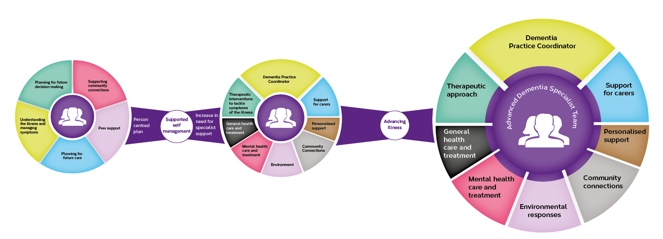
Implementing care pathways
The Wales Dementia Action Plan outlines the need to develop more formal pathways of care for
PLWD and this aligns with best practice strategy internationally.
The post-diagnostic support model in Scotland is the only documented model currently being used across the world.
The Scottish model outlines how best PLWD would be supported as their condition progresses. Beginning at Post Diagnostic Support (5 Pillars Model), through to Community-based Support (8 Pillars) and End of Life (Advanced Dementia Model).
The model:
  Enables the individual and their family to develop a robust personal plan that utilises their natural support networks
  Maintains newly developed peer support mechanisms alongside existing and new community connections
  Supports people to live well and independently with dementia for as long as possible

Slide 18
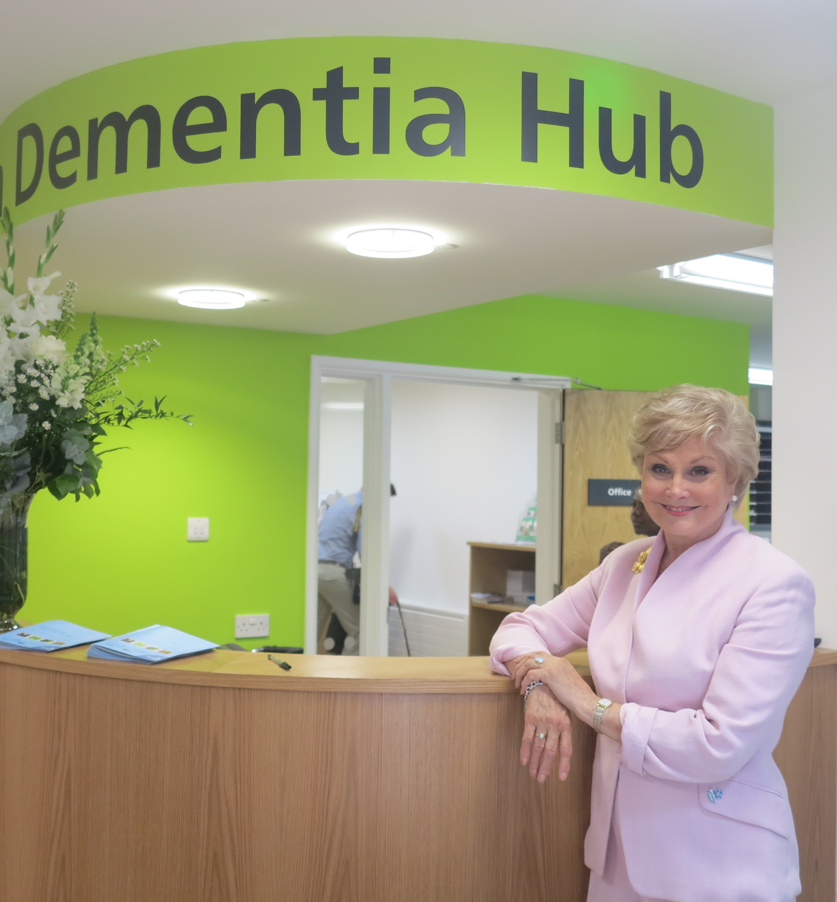
Support and care co-ordination
Family and carers play a pivotal role in enabling PLWD to live independently in communities for as
long as possible
They will pick up the majority of care, especially in the early stages if an early diagnosis has been made – both national and international strategy is focusing on the need to minimise the impact of caring for someone with dementia
They need support to build up resilience, develop the skills for caring for someone living with dementia and still be able to maintain a quality of life outside of their care for the PLWD
Access to flexible respite care is crucial so that families and carers are able to maintain quality of life
Being involved and supporting their family member with dementia to make decisions
about their care is crucial and understanding the services available is key to helping
achieve this
Dementia hubs are playing an increasingly important role in many areas, providing a
single point of access and support across a range of services for both PLWD and their
carers
Services provided in dementia hubs include:
Support staff, including dementia support workers, admiral nurses etc.
Support groups for PLWD and their carers
Access to local dementia services
Training programmes for carers
Activities for PLWD
Dementia cafés
Memory Clinics
Access to finance/ legal/ benefits advice
Involvement in research opportunities

Slide 19

End of life care
In the case of dementia, it can be difficult to predict when a person is nearing death. They may present with signs that suggest they are very close to death, but in fact can show these signs for many months, or even years
In addition, a PLWD may die from another medical condition, for example cancer or heart disease. They may also have infections and minor illnesses on top of these ongoing conditions
Other conditions and illnesses may mean the person is cared for, or ultimately dies, in a hospital or a facility that does not specialise in dementia care
Despite knowledge about end-of-life care increasing greatly over the past ten years, particularly in areas such as cancer care, many PLWD still do not receive good quality end-of-life care
Where possible, advance care planning should take place so that PLWD can make decisions about their care - early diagnosis of dementia plays a key role as a person can make decisions about their end-of-life care alongside family/carers
It is important that advance care planning is fully embedded in wider inclusive, personalised care and wellbeing planning for dementia and that support is available for Carers when a PLWD passes away
A coordinated approach between all organisations that care for a PLWD is required – so everyone understands the person’s wishes and how they want to be cared for at the end of their life

Slide 20
5. Feedback from structured interviews

Slide 21
Stakeholder Engagement
Many thanks to those who have engaged in this work:
Name
Carmarthenshire County Council adult social care service managers
Carmarthenshire County Council CRT teams
Ceredigion County Council Directors of adult social care
Ceredigion County Council Corporate Managers for Mental Health and Wellbeing and Planned Care
Age Cymru Dyfed
Pembrokeshire County Council Practitioners Forum
Pembrokeshire Association of Voluntary Services
Pembrokeshire Association of Voluntary Services Provider Forum
Hywel Dda University Health Board (HDUHB) Long term Conditions Team
HDUHB regional admiral nurse team
HDUHB Occupational Therapy Mental Health Team – Older Adults
HDUHB Acute Hospitals Dementia Wellbeing Team
HDUHB Older Adults Mental Health Team
HDUHB Heads of service - Therapies
HDUHB Dementia Wellbeing Community Team
Regional Care Home Provider Forum
Healthier Pembrokeshire Forum
Tywi Taf Cluster
Amman Gwendraeth Cluster
North Ceredigion Cluster
South Ceredigion Cluster
North Pembrokeshire Cluster
South Pembrokeshire
The development of this strategy has taken place from February 2021 through to January 2022. It has been led by Attain (an independent provider of health support services) who were commissioned by Carmarthenshire County Council on behalf of the WWCP to work with partners, PLWD and their carers to develop a dementia strategy, vision and Dementia Wellbeing Pathway across the region of Carmarthenshire, Ceredigion and Pembrokeshire. The work has been well supported by stakeholders, PLWD and their carers from across the region who have worked very hard to provide local knowledge and insight, through structured stakeholder discussions. The themes stemming from the interviews have been summarised on the following pages.
Enormous thanks goes to the 16 carers who gave up their time to provide information on the experiences of the people they are caring for as well as from their own caring perspective – this strategy would not be possible without your input.
21

Slide 22
The themes stemming from the interviews with carers have influenced the development of the service model pathway and the recommendations within this report.
Wellbeing, risk reduction and delaying onset, raising awareness and understanding
Recognition, identification and
initial support
Assessment and diagnosis
Training - Mainly have to work it out oneself especially after hospital discharge with a catheter. That was an absolute nightmare
Carers need training on how to deal with and cope with the person. I am learning as I go along
I had to work out what to do. Our finance’s, business, everything it was overwhelming
No information advice or support. It is only recently that people are beginning to help me
Couldn't get anyone to admit to the diagnosis
Absolutely no training - had to find out by myself. Got lots of leaflets but I really needed someone to sit with me and explain things
Rather a lot of confused phone calls from carers’ association. No help from the GP or the carers’ association
Stumbled along in the dark. Given support through a fluke re enquiring about council tax
Information and advice at the very beginning was great but there was no joined up thinking
Went to the GP and gave diagnosis of dementia - wanted a referral to MH services in case it was a dementia that could be treated - took 2 years
Have so much paperwork I loose track of what is what. Half the time I don’t know what to do and I don’t want to keep going on
Carers and PLWD need clear and accessible information connecting them to local peer groups for support at the outset
Never got to the bottom re diagnosis. Don't understand what type of dementia he has. I would like to know what type of dementia he has
Took ages to connect with the incontinence nurse. Now trying to get through to the dentist
No information - I was reluctant to get help, I thought I could cope. But it was so distressing
Our local library used to have a day centre. It would be useful to have a day centre to go to (Aberystwyth)
Llanethlli information and training over 4 weeks was very helpful - addresses numbers, websites, of services
What provision is there to protect people with dementia who live on their own? Should be high for identification of frailty in GP surgeries
Best people who have helped - Alzheimer’s society, I get a call every month and advice on how to claim attendance allowance
No joined up thinking from the psychiatric dept. Just handed us over to the GP who did nothing

Slide 23
The themes stemming from the interviews with carers have influenced the development of the service model pathway and the recommendations within this report.
Assessment and diagnosis
Living well with dementia
The need for increased support
We saw so many people in the first 12 months. First contact was crossroads and was sign posted to a lot of different activities e.g. dementia cafes
It would be good to have a person help sort out my problems rather than me trying to sort things out and find my way
COVID - Made things 10 time worse as you can't meet anyone. Day service in Cardigan has closed and would have been good to take her
Used to do zoom - music - oblivious to it all. Didn’t work for my husband and other carers have said that zoom really doesn't work for those with dementia
Admiral nurse came out and went with the carers to see mum to help support them with their caring role - if mum refuses will leave it up to the family
Diagnosed in 2019. Saw the consultant twice, was given a prescription and not seen anyone since
Doesn’t appear to be any activities - quite rural where we live and have to travel half an hour to get anywhere (Ceredigion)
To have a day centre specifically for people with dementia or people present to support people with dementia would be good
Consultants in hospitals need to be trained in power of attorney for health. Hospital staff need training - They lost his glasses, hearing aids and his bottom teeth
Everyone has been wonderful after dad fell - social worker, she acted straight away she liaised with the hospital and got him a place in a nursing home
I was inundated with leaflets and phone calls but I had no idea as to who they were, it was a step into a very deep pool
So many services are providing support but are not talking to each other so I have to tell them what has happened
Made it through lock down with no respite and reduced respite now. Please reinstate all day-care facilities. Carers and those with dementia need it
I live out of the area and find it difficult to know what services there are in my mum’s area. GP surgery try to keep in contact
The guilt and stress when he had to go into a home, failure, marriage vows come into question - splitting myself in half - relief and guilt
2019 GP had tried to do a dementia test but my husband couldn't hear. I asked to be referred to hospital. 1yr later was referred
I feel now that he has his diagnosis, I can call on people but there is nowhere to go. Could be sat in 5 days a week - there is nothing (Carms)
More than one carer asked for activities targeted at younger people. List of activities sent out to carers each week is phenomenal - lots of things to do (Pembs)
Direct payment: Great as you can have the money but no good if you can't get the care in place
Very disappointed in the care - it was a dementia specialist ward no specific treatment didn’t even check if he was eating or drinking

Slide 24
The themes stemming from the interviews with frontline staff have influenced the development of the service model pathway and the recommendations within this report.
Wellbeing, risk reduction and delaying onset, raising awareness and understanding
Recognition, identification and
initial support
Assessment and diagnosis
We need a clear understanding of what happens when people get information e.g. who can they turn to for support?
Signposting by GP receptionists can help people access 3rd sector services
People are hitting crisis but don’t have a diagnosis – difficult to get CHC without a diagnosis
Support should be provided regardless of diagnosis, including CHC, as it is based on need
Training for all - basic understanding to managing complex behaviours - enabling people to recognise signs, what to expect to support PLWD
We need to maximise the use of DEWIS across the region by professionals and the public
Delaying things results in emergency admissions and those being admitted have more chronic conditions
Community activities need developing and co-ordinating – Pembrokeshire is more mature
There are lots of organisations and communities and it can be a barrier for PLWD/carers to access
We need a standardised approach to diagnosis regardless of where it takes place
Accessing GP, dentist, hearing clinics has become more difficult since COVID - people jumping through hoops and increases stress for the carer
Support care home staff through providing honest information on discharge so they can meet all the person needs. Support staff through training
MDT based in primary care could be making straight forward diagnosis. MAS should be focusing on specialist diagnosis
Carers and PLWD need clear and accessible information connecting them to local peer groups for support at the outset
We need a clear assessment/diagnosis pathway that sits outside mental health services
All staff including dom care and care homes need to be trained to recognise the signs of dementia, especially for those who are deaf, blind and Welsh speakers
We need to raise awareness of young onset dementia and clear pathway and service offer is needed
Access to local networks is better in some areas than others. There is no regional strategic approach to supporting carers
How do people get support without a diagnosis? Dementia is considered separately but shouldn’t be, it’s very much part of frailty
There needs to be consistency in how people access GP appointments - PLWD many not be able to get past the receptionist or triage

Slide 25
The themes stemming from the interviews with front line staff have influenced the development of the service model pathway and the recommendations within this report.
Assessment and diagnosis
Living well with dementia
The need for increased support
Need formal process for secondary care consultant diagnosis and read code included into discharge – how care homes and GPs are made aware
Proactive care planning through HOLISTIC MDT - consistent approach across the region, providing support wellbeing plan around the person
Maximise the use of technology, for professionals, PLWD and their carers e.g. connect carers to support via an APP on the hospital bed Ipads
Education - Training and advice from the Dementia Wellbeing Team (DWT), consider widening membership to include social care and 3rd sector
Care plan and emergency care plan in place for the carer
Is it possible to develop: cognitive assessment for Welsh speakers, people who are blind and a fast track assessment for dementia?
Virtual day services may require a carer present to facilitate. PLWD benefit from being in groups without the carer
Optimise patients wellbeing whilst in hospital through admissions check list - diagnosed, working diagnosis etc. - better use of the acute based DWT
We need to be clear that any new way of working will need to be fully resourced
Training in behavioural interventions is needed for carers and dom care providers – preventing unnecessary residential placements
As the condition progresses the cross over to health services is often difficult and needs to be better. People are hitting crisis but not getting diagnosed
Can social care and 3rd sector become part of the regional dementia wellbeing team?
There needs to be a consistent approach to medication monitoring, review and prescribing in primary care across the region
Community transport colleagues can help MDTs by providing relevant information in relation to the patient
Dementia recognition tool can help the development of behavioural management plans, key behaviours and what interventions can be used
Belief that it can only take place in MAS setting. There is a need for MDT approach to diagnose and prescribe in the community e.g. GPs /AHPs who are fully trained
The overarching thing not addressed is base line wrap around the person, a co-ordinator throughout their journey
Many things are on offer for carers but the ICF carers funding stream is not joined up with the dementia ICF funding stream so there is duplication of effort
Need to ensure employers assess for and implement reasonable adjustments to enable the PLWD services to work
Lots of organisations are going to people’s homes and are not talking to each other so people have to keep repeating themselves
Further themes stemming from initial conversations with stakeholders can be found in appendix 2

Slide 26
6. West Wales Dementia Service Vision and Wellbeing Pathway
The following pages contain the dementia service vision and Wellbeing Pathway which builds on the Attain best practice research report circulated in January 2021. This service model pathway has endeavoured to incorporate existing services in West Wales. The service vision and Wellbeing Pathway has been co-designed through engagement with staff from across the region, PLWD and their carers.
The All Wales Dementia Action Plan 2018-2022: As a signatory to the Glasgow Declaration (1) the Welsh Government has previously committed to promote the rights, dignity and autonomy of people living with dementia. Through their engagement with stakeholders they heard about the positive work of Dementia Action Alliance in developing a series of statements with people living with dementia and their carers (2). We have aligned these statements to our Dementia Wellbeing Pathway.
https://link.edgepilot.com/s/67f68721/ecxOvtDsBECT3n7RjIzvhg?u=https://www.alzheimer-europe.org/Policy/Glasgow-Declaration-2014
https://link.edgepilot.com/s/8d37d66b/NmKURNiXoUaKCjtzSUiWhQ?u=https://www.dementiaaction.org.uk/nationaldementiadeclaration

Slide 27









DRAFT - West Wales vision for dementia services
‘Support each person to live well and independently with dementia for as long as possible’
Key enablers to delivery:
Clear regional dementia vision, strategy and service model in line with best practice
Develop effective professional and clinical leadership and governance to ensure the service model and new roles are designed in line with best practice and are part of the whole health and social care system
Strategic and collaborative PLWD/carer centred commissioning arrangements
Cross-organisational working
Collective financial and performance management
Specialist dementia care support – in the community and in hospital
4. Help long term
Intermediate care to support people at the time of increasing need. We maximise comfort and wellbeing – supporting people in their home if possible
Joint commissioning for integrated care, ensuring equity of access and provision across West Wales
Optimise the use of estate - build on localities and provide support closer to home e.g. local meeting places/hubs where people can connect
Adapting IT so that it reflects activity and captures person centred outcomes. ​
Shared system transformation programmes and plans
Systematic involvement of PLWD and their carers and community in the design and development of the new service model
3. Help when you need it
Proactive Care and Care Planning as a multi-disciplinary team. Care is co-ordinated ensuring the right help, at the right time
2. Help to help yourself
New ways of working expanding the capacity of the Good Work training framework and new workforce roles e.g. Dementia wellbeing connector role
Using technology to empower PLWD and their carers and our staff.​
Commissioning and provision of primary care services at scale
Interpret population health/social care data, PLWD/family feedback, design services for networks and draw in support from wider services
Prevention, Planning and Education within our communities
Communities prepared to support and help
1. Help for strong communities

Slide 28
What good looks like for West Wales –
The Dementia Wellbeing Pathway
Working with partners across West Wales we have developed our Dementia Wellbeing Pathway together focusing on streamlining pathways and placing the PLWD and their carers at the centre of our service provision. We will implement strategies to increase early diagnosis, supporting GPs and allied health professionals in primary care with specialist input where needed as part of an MDT approach to community assessment and diagnosis and to improve the quality of referrals to specialist services.
We will focus on implementing best practice within primary care, social care, care homes, domiciliary care and specialist services​. Implementation of the Dementia Wellbeing Pathway will include the development of the diagnostic pathway and post diagnostic support,​ support and co-ordination for PLWD and their carers​ and supporting carers to care for family members living with dementia​. We will provide support, training and help to navigate/co-ordinate services to families, build resilience and maintain balance across all aspects of their life​. We will improve end of life care so that PLWD die in a place of their choosing with dignity​ and improve co-ordination across different care providers to ensure they understand the end-of-life care plan.

Slide 29
Dementia action plan Wales 2018-22
As a signatory to the Glasgow Declaration (1) the Welsh Government has previously committed to promote the rights, dignity and autonomy of people living with dementia. Through the Government’s engagement with stakeholders they heard about the positive work of Dementia Action Alliance in developing a series of statements with people living with dementia and their carers (2)
Dementia Statements reflect the things that people with dementia and carers say are essential to their quality of life. These statements were developed by people with dementia and their carers, and the person with dementia is at the centre of these statements. The “we” used in these statements encompasses people with any type of dementia regardless of age, stage or severity; their carers; families; and everyone else affected by dementia.
These rights are enshrined in the Equality Act, Mental Capacity legislation, Health and care legislation and International Human Rights law and are a rallying call to improve the lives of people with dementia. These Statements recognise that people with dementia shouldn’t be treated differently because of their diagnosis.
We have aligned the dementia statements to the new West Wales Dementia Wellbeing Pathway and the recommendations within this strategy have also been aligned.
For more information see:
https://link.edgepilot.com/s/67f68721/ecxOvtDsBECT3n7RjIzvhg?u=https://www.alzheimer-europe.org/Policy/Glasgow-Declaration-2014
https://link.edgepilot.com/s/8d37d66b/NmKURNiXoUaKCjtzSUiWhQ?u=https://www.dementiaaction.org.uk/nationaldementiadeclaration

Slide 30

What good looks like for West Wales –
The draft dementia wellbeing pathway
Wellbeing, risk reduction, delaying onset, raising awareness and understanding
Creating dementia friendly communities, making dementia everybody's business
We have the right to continue with day-to-day and family life, without discrimination or unfair cost, to be accepted and included in our communities and not live in isolation or loneliness.
What matters to you
Resilient
communities
education
transport, housing
and enabling tec,
dementia friendly
communities
Access to community
transport, sport,
leisure, art and
social activities
Public awareness
of the 6 steps
to reduce the
risk of dementia
Support/advice for all
inc finances, lasting
power of attorney,
Psychological/
mild cognitive
impairment
Pharmacy,
audiology,
ophthalmology
and dental services
provide support
and are accessible
Adapted wellbeing
information
available through
condition
People who are well, pre-clinical
and/or have mild cognitive
impairment
Underpinned by communication plan, recognising experts by experience, access to assistive technology etc. Implementation of the Recognition and Good Work Training Frameworks

Slide 31

What good looks like for West Wales –
The draft dementia wellbeing pathway
Recognition, Identification, Support and Training
Each person gets fair access to care regardless of diagnosis
We have the right to be recognised as who we are, to make choices about our lives including taking risks, and to contribute to society. Our diagnosis should not define us, nor should we be ashamed of it.
Dementia friendly Local Authority services
e.g. Delta Connect, social care, ART/CRT
and hospitals, WAST, training for all
Access via community connectors, admiral
nurse, word of mouth - people in the
local community, maximise DEWIS Cymru
What matters to you
Information,
advice and
assistance.
Help to max income
and stay in employment
Recognition when an
individual needs advocacy
and support
Access to 3rd
sector services
Sign posting to local
groups, neighbourhood
networks, carers groups
peer groups,
3rd sector
Access social prescribing via:
community connectors, GPs and AHPs
Local Authorities, 3rd Sector,
Pharmacists, GP Surgeries etc.
People who are well, pre-clinical
and /or have mild cognitive
impairment
Underpinned by communication plan, recognising experts by experience, access to assistive technology etc. Implementation of the Recognition and Good Work Training Frameworks

Slide 32

What good looks like for West Wales –
The draft dementia wellbeing pathway
Assessment and diagnosis
Each person is seen as an individual
We have the right to an early and accurate diagnosis, and to receive evidence based, appropriate, compassionate and properly funded care and treatment, from trained people who understand us and how dementia affects us. This must meet our needs, wherever we live.
Development of initial wellbeing care
plans for PLWD and Carer
Access via local publicity
Community/dementia wellbeing
connectors, maximise Dewis Cymru
Diagnosis takes place in a
community MDT, hospital, MAS
Planning for the future for both the Carer and PLWD
Use of universal services e.g. libraries, fitness
e.g. lasting power of attorney
centres, community centres
Robust suit of e learning for all
and face to face training.
Community MDTs, 3rd Sector,
Local Authorities,
Care Homes Pharmacists, GP and AHPs
property/finances
health and
welfare
Understanding
the illness and
managing the symptoms.
People who have mild to
moderate dementia
Assistive
technology,
Access social prescribing
and flexible, creative respite
information advice, assistance, advocacy and support ongoing
Robust
standard screening for delirium
Short term
support for person
with early signs of
dementia and Carer.
Support for those who
don’t see themselves
as a carer
Underpinned by communication plan, recognising experts by experience, access to assistive technology etc. Implementation of the Recognition and Good Work Training Frameworks

Slide 33
What good looks like for West Wales –
The draft dementia wellbeing pathway
Living well with dementia
Care is co-ordinated
We have the right to be respected, and recognised as partners in care, provided with education, support, services, and training which enables us to plan and make decisions about the future. We have the right to know about and decide if we want to be involved in research that looks at cause, cure and care for dementia and be supported to take part.
Proactive care planning through HOLISTIC MDT (colleagues enabled to attend virtually) - consistent regional approach, providing stable support and wellbeing plan around the person and where appropriate, their carer, regardless of diagnosis including:
Holistic MDT wellbeing planning as
part of frailty and dementia model
Located in primary care dementia
wellbeing connectors supporting
PLWD/Carer along the journey
Dementia wellbeing connector
GP
Advocate
Social care
District nurse (DN)
Allied health professionals (AHPs) e.g. OTs, physio, dietetics, speech and language etc.
Key workers/ assistive technology lead
Admiral nurse
Primary care
3rd sector
Pharmacist
Psychologist
Care homes
Older Adult mental health
Adult MH for young onset
Advice and advice on training as required from DWTs in the community and acute settings
Secondary care and SPC consultants as required
General health, medication review
and mental health
Dementia
Wellbeing connector supporting the PLWD and co-ordinating system
/psychological support for both the PLWD and
Planning for the future
support wrapped around you
Hospitals, demand led MAS satellite
Clinics, OA MH and dementia
wellbeing team (DWT) support
Access as part of wellbeing plan
Formal/informal arrangements
their Carer
wrap around
Specialist support for the PLWD Anticipatory bereavement for carers
People living with dementia
Person centred
wellbeing
living for PLWD and their Carers. Environmental
adaptation, tec,
Wellbeing plan review minimum 6
months persons, physical condition
and their environment included
.
Access as part of wellbeing plan
formal/informal arrangements
.
supported
housing
Proactive care planning enabling people to have
Personalised support for the PLWD and
the carer when
needed e.g wellbeing
activities
a good quality of life
and remain in their
own environment for as long as possible
Underpinned by communication plan, recognising experts by experience, access to assistive technology etc. Implementation of the Recognition and Good Work Training Frameworks

Slide 34
What good looks like for West Wales –
The draft dementia wellbeing pathway
Increased support when you need it
All staff are prepared to care
Wherever I am, health and care staff bring empathy, skills and expertise and give me competent, confident and compassionate care.
Proactive care planning through HOLISITC MDT (colleagues enabled to attend virtually) - consistent regional approach, providing stable support and wellbeing plan around the person and where appropriate, their carer, regardless od diagnosis including:
Holistic MDT wellbeing planning as part
of frailty and dementia model
Holistic MDT wellbeing plan inc. EOLC,
access to meds, psychological
support for PLWD and Carer
Dementia
Dementia wellbeing connector
GP
Advocate
Social care
District nurse (DN)
Allied health professionals (AHPs) e.g. OTs, physio, dietetics, speech and language etc.
Key workers/ assistive technology lead
Admiral nurse
Primary care
3rd sector
Pharmacist
Psychologist
Care homes
Older Adult mental health
Adult MH for young onset
Advice and advice on training as required from DWTs in the community and acute settings
Secondary care and SPC consultants as required
Integrated MDT, EOLC, bereavement for carers and PLWD,
wellbeing
connector - system
Planning for the future
support wrapped
around you
wrap around
(e.g. 3rd sector, rapid response service as/
developed as part of a care plan
Dementia enabling hospitals, social
care, care homes, MAS, DWT clinics,
district nursing, primary care
Dementia wellbeing connector
supporting PLWD and carer
through to end of life
when
Meaningful
needed
living
Mental health and general health
support for the PLWD
for PLWD and their carers. Environmental
adaptation, TEC,
People living with
dementia
and their carer
Supported
Frequent MDT review of wellbeing
plan persons physical state and
environment included
housing
Access as part of care plan formal
/informal arrangements/timely
continuing healthcare at home
.
Proactive care planning and support providing
Personalised
support for the PLWD/
carer e.g. nutritional
quality of life in their
Specialist support for the PLWD
risk screening,
support when
Implementation of the Good Work Framework - we need to consider the learning and development needs of everyone who is affected in some way by dementia. This includes people living with dementia, carers, frontline staff, managers, commissioners, regulators, researchers, shopkeepers, next door neighbours etc. Resulting in people who are informed, people who are skilled and people who can act as influencers
own homes for as long as possible
PLWD placed in
e.g. Regional community and acute Dementia Wellbeing Teams
residential care
Underpinned by communication plan, recognising experts by experience, access to assistive technology etc. Implementation of the Recognition and Good Work Training Frameworks

Slide 35
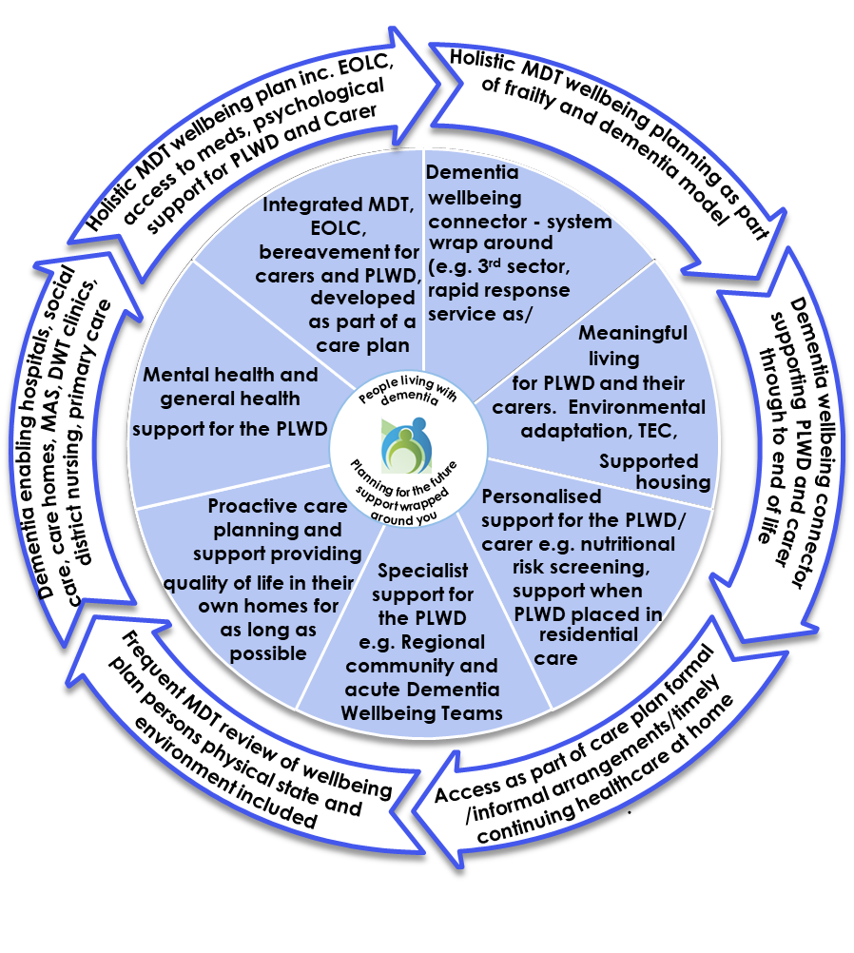

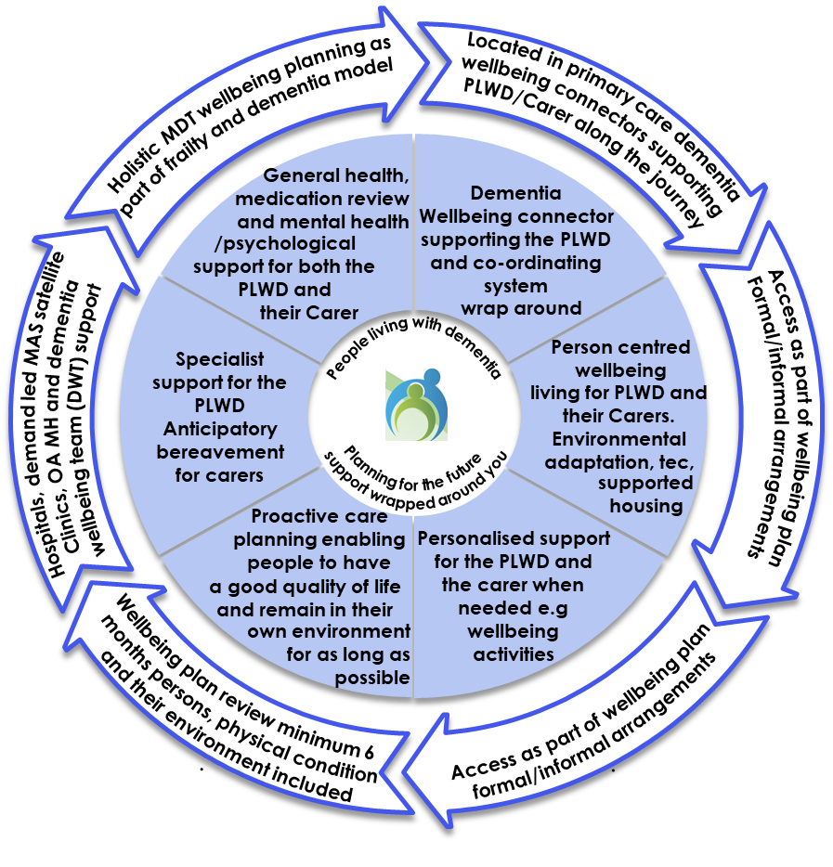
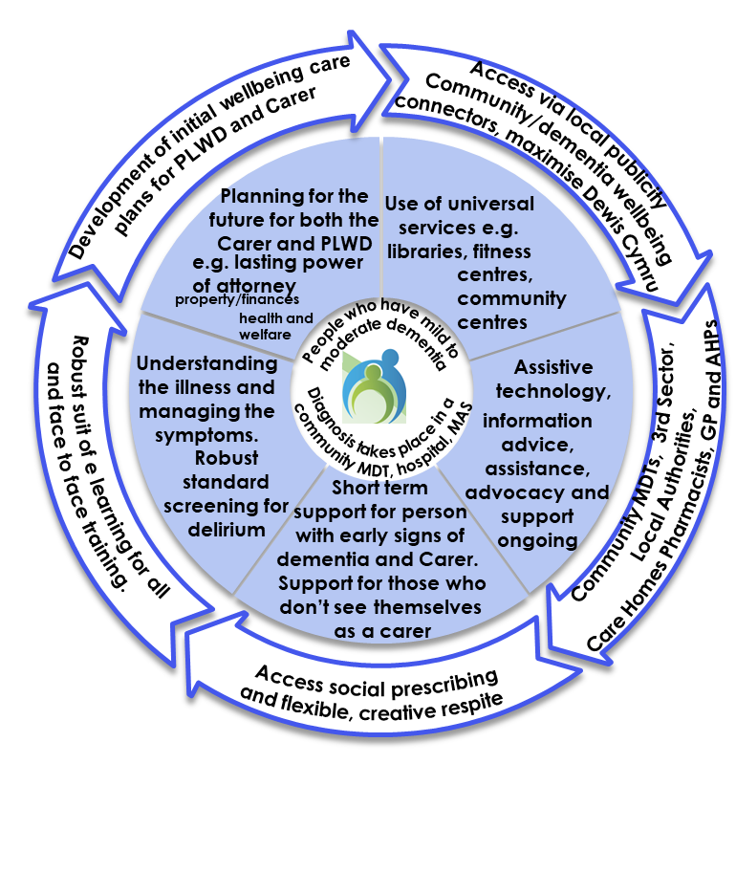
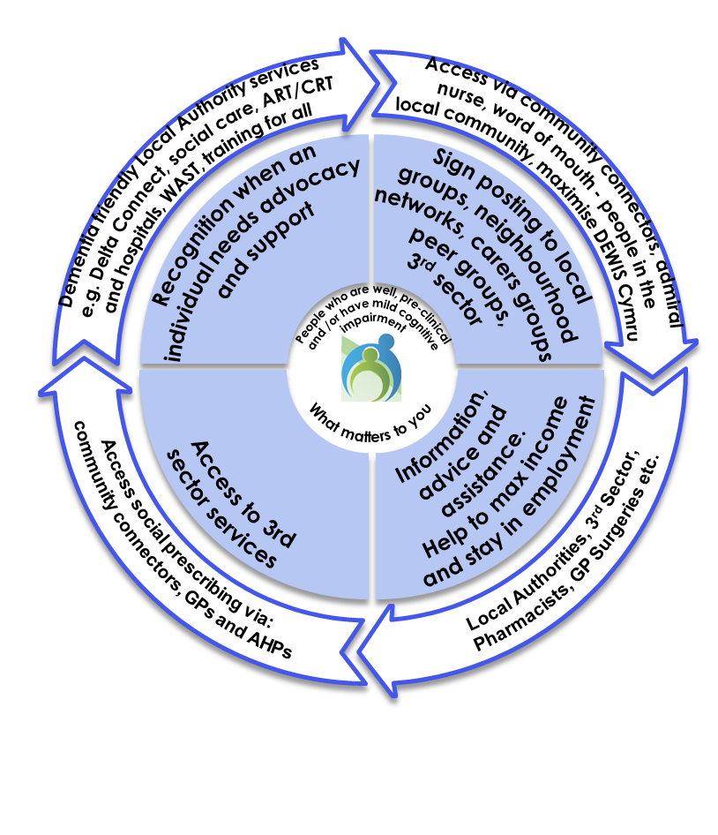
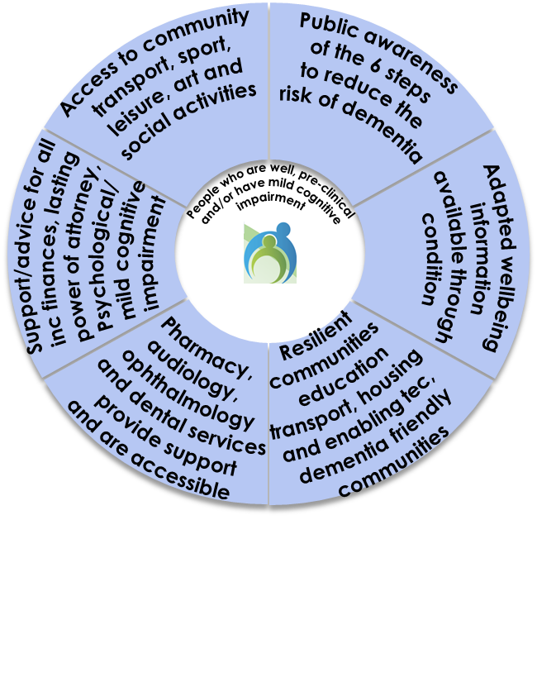
What good looks like for West Wales –
The draft dementia wellbeing pathway
Team around the person - support increases with needs
Experts influencing across the pathway
This pathway places the PLWD and their carer at the centre of service support. It illustrates a new more joined up way of providing services. It is based on best practice and existing services within West Wales.
The service model should be underpinned with an agreed set of service operating procedures which need to be to be developed
Underpinned by communication plan, recognising experts by experience, access to assistive technology etc. Implementation of the Recognition and Good Work Training Frameworks

Slide 36
Services aligned to the dementia wellbeing pathway
Wellbeing, risk reduction and delaying onset, raising awareness and understanding
Recognition, identification support and training
Information, Advice and Assistance - Local Authority’s statutory responsibility. Initial advice and information is provided at the initial entry point into social care.
  Delta - for Carms,
  Porth Gofal for Ceredigion
  XXX for Pembs.
Community networks
3rd sector services/activities
Community/dementia wellbeing connectors/
social prescribers
Local authority staff e.g. social care support workers, social workers, domiciliary care, Delta Connect,
GPs and primary care staff
Allied health professionals
District nurses
CRT/ART teams
Care homes
Community transport
Hospital heath staff
Welsh ambulance service
Everyday services
Assessment and diagnosis
MDT assessment in the community by trained staff with support from MAS. Hospital based MAS assessment for specialist diagnosis
Community MDT: Dementia wellbeing connector, GPs, allied health professionals, nurses (all fully trained) see list on wheel 3 MAS – community based
MAS hospital based
3rd sector – initial information and support post diagnosis
Admiral nurse
Living well with dementia
Community MDT proactively care planning with dementia coordinator
Person centred wellbeing activities available across the 3 counties to meet the needs of PLWD for both young and old
Everyday services
Incresed support when you need it
Timely access to services including CHC assessment, care packages agreed regardless of dementia diagnosis
Dementia wellbeing connector
Admiral nurse
CRT/ART – health and social care
Local authority staff e.g. social care support workers, social workers, domiciliary care, Delta Connect
Care homes
GPs and primary care staff
Allied health professionals
District nursing
Specialist palliative care services
Dementia wellbeing service community
Dementia Wellbeing service hospitals
Everyday services:
Community networks and activities
Sports and leisure activities
Health and arts activities
Libraries
Cinemas
Shops
GP surgeries
Police
Fire service
Dentists
Opticians
Audiology
Pharmacies
Education
Housing
Transport
People with cognitive impairment should be able to be as independent as possible with people supporting them in everyday life. Access to services and support should be regardless of diagnosis. The pathway is designed to enable wrap around care for the PLWD and their carer, with people accessing support as and when they need it.

Slide 37
7. Our approach to Implementing the Dementia Wellbeing Pathway
The following slides summarise the priority areas required in order to implement the new dementia strategy and well being pathway.
Along with the co-design of the Dementia Wellbeing Pathway, the priority areas have been identified following extensive stakeholder engagement across West Wales and take into account best practice as well as the All Wales Dementia Action Plan and the recently published All Wales Dementia Care Pathway Standards.
The All Wales Dementia Action Plan 2018-2022: As a signatory to the Glasgow Declaration (1) the Welsh Government has previously committed to promote the rights, dignity and autonomy of people living with dementia. Through their engagement with stakeholders they heard about the positive work of Dementia Action Alliance in developing a series of statements with people living with dementia and their carers (2). We have aligned these statements to our priorities and recommendations.
https://link.edgepilot.com/s/67f68721/ecxOvtDsBECT3n7RjIzvhg?u=https://www.alzheimer-europe.org/Policy/Glasgow-Declaration-2014
https://link.edgepilot.com/s/8d37d66b/NmKURNiXoUaKCjtzSUiWhQ?u=https://www.dementiaaction.org.uk/nationaldementiadeclaration

Slide 38

Wellbeing, risk reduction, delaying onset, raising awareness and understanding
Creating dementia friendly communities, making dementia everybody's business
We have the right to continue with day-to-day and family life, without discrimination or unfair cost, to be accepted and included in our communities and not live in isolation or loneliness.
What we are doing and our plans in this area:
Implementation of the Good Work framework – Training for ALL | Refresh the West Wales learning needs analysis training framework and work with partners to implement it. Ensuring that training provided is evidence and rights based approach where appropriate and to also build in training provided by the Welsh Government to help achieve the implementation of the All Wales Dementia Care Pathway of Standards (AWDCPS) All staff, including those in everyday services and services such as domiciliary care and care homes, to be trained to recognise the signs of dementia and be trained in how best to support PLWD - appropriate to the level of contact - from basic understanding to managing behavioural expression of unmet need - enabling generic services (e.g. social work, personal assistants, domiciliary care, care homes, district nursing, OT, physio etc.) to support PLWD especially for those who are deaf, blind and Welsh speakers Training for all staff in basic understanding to managing person centred care/behavioural expression of unmet need - enabling people to recognise signs, what to expect to support PLWD Arrange for those professionals who are interested to be trained through the All Wales faculty dementia diagnosis course which is available for all professionals – consider if a bespoke regional training would be appropriate for the West Wales region Ensure there is access to training in behavioural interventions for carers and domiciliary care providers – preventing unnecessary residential placements All Wales Dementia Care Pathway of Standards (AWDCPS) Within 12 weeks of receiving a diagnosis, PLWD will be offered education and information on the importance of physical health activities to support and promote health. (AWDCPS 9) Implementing the All Wales expert by experience courses (Licenced by Harvard university) - PLWD, carers and families will be offered learning, education and skills training. This offer will be stage appropriate and will be provided at significant parts of a person’s journey. It will include a range of peer support and shared experience opportunities. (AWDCPS 10) All staff delivering care at all levels within all disciplines and settings, will have the opportunity to participate in person centred learning and development with support to implement into daily practice. This will be a joint regional approach to identifying a range of learning and development opportunities including quality improvement. (AWDCP 17)
Communication, raising awareness enabling access to timely information/ services | Promote the UK and Welsh Government public health messages across the region Raise awareness of young onset dementia and develop a clear service offer Carers and people living with dementia (PLWD) need clear and accessible information connecting them to local peer groups for support at the outset Maximise the use of DEWIS across the region by professionals and the public Create a standard approach across organisations for the provision of information to PLWD and their carers Primary care consider how PLWD access GP appointments - PLWD may not be able to get past the receptionist or the triage system​ if living on their own The introduction of a Dementia wellbeing connector role, which will work with local services within the communities they are aligned to and will enable better access to everyday services such as dentists, opticians and GP surgeries Develop a range of individual and group based physical and activity based interventions and opportunities that are person centred for PLWD to access Recognise that transport, particularly in rural areas, to get people to community activities is challenging and identify ways of addressing this

Slide 39

Recognition, identification support and training
Each person gets fair access to care
We have the right to be recognised as who we are, to make choices about our lives including taking risks, and to contribute to society. Our diagnosis should not define us, nor should we be ashamed of it.
What we are doing and our plans in this area
Proactively supporting people | Strengthen access to local networks across the region for those with mild cognitive impairment and for those with dementia Ensure dementia is an indicator as part of risk stratification within primary care and PLWD and their carers who require support receive proactive MDT care planning with support from the Dementia wellbeing connector Develop a proactive case management approach (shared care/decision making) through MDT working, developing plans to lower the likelihood of PLWD hitting crisis, even for those who don’t have a diagnosis All Wales Dementia Care Pathway of Standards (AWDCPS) People living with Mild Cognitive Impairment (MCI) will be offered a choice of holistic services monitoring their physical, mental health and wellbeing, with reviews taking place as a minimum six monthly. This will include a range of options including peer support. Signposting and community resources should be at the centre of all intervention (AWDCPS 8).
Support regardless of diagnosis | Carers and people suspected of highly likely living with dementia to access clear and accessible information connecting them to local peer groups for support at the outset Carers and people suspected of highly likely living with dementia receive advice and support in relation to managing their every day lives throughout their journey Community activities need developing and co-ordinating for people suspected of highly likely living with dementia and their carers – activities should be person centred and be available regardless of diagnosis
Enabling structures | Develop a regional strategic/co-ordinated approach to supporting carers – consider top slicing the dementia ICF funding to be included in the carers’ ICF funding, thereby ensuring all carers’ services support those who are caring for people living with dementia Review CHC assessments which have taken place over the past 18 months to identify whether people are accessing CHC regardless of a dementia diagnosis – develop a report and action plan to address, if needed Develop a comprehensive communication programme to promote the strategy and its messages. Keep the plan alive and ensure the public are aware of any new service developments in their area or across the region. Regularly report progress and review the plan via the WWCP Dementia Steering Group

Slide 40
Assessment and diagnosis
Each person is seen as an individual
We have the right to an early and accurate diagnosis, and to receive evidence based, appropriate, compassionate and properly funded care and treatment, from trained people who understand us and how dementia affects us. This must meet our needs, wherever we live.
What we are doing and our plans in this area
Getting the diagnosis pathway and information right first time | Develop a regional diagnosis pathway, maximising the use of AHPs, designing new ways to diagnose in the community, develop an outline business case to implement the new pathway with modelled resourcing. The new pathway will include the implementation of the AWDCPS: 3, 5, 6, 7 and 15 – (See standards below). Ensure the new pathway includes a formal process for acute hospital consultant diagnosis and READ codes included into discharge papers – so care homes and GPs are made aware Following the recent development of an outline business case, develop a full business case for the Dementia wellbeing connector role, to include system savings aligned to a phased roll out. WWCP dementia steering group to agree the preferred option. Develop plan to implement the new role. All Wales Dementia Care Pathway of Standards (AWDCPS) Memory Assessment Services (MAS) and Primary Care (GP) will adopt the READ Codes. Those diagnosed with dementia within settings outside of MAS (including primary care, community resource teams, psychiatric liaison and neurology) will provide the GP and MAS the specific READ Code within two weeks of a diagnosis (AWDCPS 3) Health and social care services will provide the correct information to assist MAS when they undertake assessments and in providing diagnosis. This will also support the person to manage any identified daily living difficulties. (AWDCPS 5) MAS, within a 12 week period from point of referral, will provide a range of interventions (listed in the AWDCPS 6) to support diagnosis. Consider what digital platforms and other adaptions and approaches are needed to enable the implementation of this standard. People will have access to a contact that can provide emotional support throughout the assessment period and over the next 48 hours after receiving a diagnosis and ensure following this period, it is offered as required. (AWDCPS7) People within 12 weeks of being diagnosed with dementia will be offered support to commence planning for the future, including end of life care. This offer will include the opportunity to revisit and update this plan throughout the person’s journey. Where appropriate, representation and the use of advocacy will ensure the rights of the person are upheld. (AWDCPS 15)
Supporting those with a learning disability | Ensure the processes in place enable a person with a learning disability receives a cognitive wellbeing check All Wales Dementia Care Pathway of Standards (AWDCPS) Learning Disability (LD) services will define a process to capture the total population of people living with a learning disability and specifically Down Syndrome to offer a cognitive wellbeing check. (AWDCPS 4)

Slide 41

Living well with dementia
Care is co-ordinated
We have the right to know about and decide if we want to be involved in research that looks at cause, cure and care for dementia and be supported to take part. We have the right to be respected, and recognised as partners in care, provided with education, support, services, and training which enables us to plan and make decisions about the future.
What we are doing and our plans in this area
Enabling people to have health reviews and to attend appointments | Following sign off of the full business case, roll out of the Dementia wellbeing connector service which will promote proactive care planning through HOLISTIC MDT - consistent approach across the region, providing stable support wellbeing plan around the person – develop a regional holistic care plan template Dementia wellbeing connector to co-ordinate support throughout a person’s journey Develop a pre and post diagnostic service (PPDS) standard operating procedure. This will set out expectations, processes and data recording requirements from the PPDS. Develop a consistent approach to medication monitoring, review and prescribing in primary care across the region All Wales Dementia Care Pathway of Standards (AWDCPS) PLWD will have a current face to face appointment where a physical health review will be delivered in partnership by primary and secondary care. Where there is justifiable reason for not providing a face to face appointment, a physical health review will be delivered by other approaches i.e. digital platforms, telephone consultation. (AWDCPS 14) PLWD, their carers and families will have support and assistance to engage with appointments. This will avoid receiving multiple health and social care appointments that can overwhelm, confuse and isolate the person. Practical streamlining of operational processes will support the service to avoid duplication and maximise opportunities to exercise prudent principles to service delivery. (AWDCPS 18)
System wide response | Support PLWD to live well; continue with implementing the Journey Through Dementia OT programme which includes implementing ‘dementia-friendly design principles’ within peoples own environments and any new building or service Ensure employers assess for and implement reasonable adjustments to enable the PLWD to work Regardless of diagnosis, Dementia wellbeing connector role to act as the co-ordinator for the PLWD reducing the likelihood of them or their carer having to repeat their story or to be accountable for relaying information between services – capturing the essence of who the person was - explore using the patient knows best APP Review ALL initiatives currently funded by the Regional Integrated Fund, evidencing outcomes, align funding to implement strategic priorities, ensure any new way of working is fully resourced Consider whether social workers from each county and 3rd sector colleagues could become part of the regional dementia wellbeing community team Review community activities available across the region for PLWD and support activities for carers. Address gaps, including activities for those with young onset dementia Maximise the use of technology, for professionals, PLWD and their carer e.g. connect carers to support via an APP on the hospital bed Ipads Implement the remaining actions from the All Wales Dementia Action plan Identify an area in which to implement the All Wales Dementia Care pathway Standards in line with the 2 year programme of work outlined in the standards. (AWDCPS 1) All Wales Dementia Care Pathway of Standards (AWDCPS) Services at the points of contact will provide reasonable adjustments to care that is meeting the person’s needs and personal preferences.(All Wales Dementia Care Pathway Standard 2) Person-centred reasonable adjustments will support the person to live well by maximising their independence and ability to participate in their communities. (All Wales Dementia Care Pathway Standard 2) People living with dementia and their carers will have a named contact (connector) to offer support, advice and signposting, throughout their journey from diagnosis to end of life. (AWDCPS 12) People living with dementia will have access, when needed, to relevant (and when accessing mental health services) dedicated services post diagnosis no matter their residence. This identifies with the care and team wrapped around the individual (AWDCPS 13) Organisations and care settings providing intensive dementia care (this includes mental health and learning disabilities inpatient settings) implement the dementia care mapping tool to evaluate and learn about person-centred enabling practice. Supporting clinical reasoning and decision making. Mental health DCM services will offer DCM support to acute care, prisons and care homes settings. (AWDCPS 16) Working in partnership, the region will deliver on the requirements of the agreed data items (measurement workbook) for reporting and assurance. (AWDCPS 20)

Slide 42

Increased support when you need it
All staff are prepared to care
Wherever I am, health and care staff bring empathy, skills and expertise and give me competent, confident and compassionate care.
What we are doing and our plans in this area
Consistent care while in hospital | Optimise patients’ wellbeing while in hospital through admissions and discharge check list - diagnosed, working diagnosis etc. Fully adopt the Dementia Friendly Hospital charter, raising awareness among staff and volunteers, preventing issues such as personal effects getting lost or hearing aids not being put in correctly – develop action plan to implement and regularly review through the WWCP Dementia Steering group Ensure hospital staff are trained to understand what power of attorney for health means All Wales Dementia Care Pathway of Standards (AWDCPS) Wales will adopt the Dementia Friendly Hospital Charter with a regular review of implementation and outcomes. (AWDCPS 11).
Maximise the power of MDT working, accessing support when you need it | Develop a regional, standard, interdisciplinary care plan and through proactive MDT working which enables colleagues to join virtually, and shared decision making with the patient and carer, plan ahead to prevent crisis as well as to increase support as and when it is needed including agreeing ceilings of care - consider if the plan should be placed in an APP that can be accessed by the patient, carers and colleagues Maximise the circle of support e.g. community transport colleagues can help MDTs by providing relevant information in relation to the patient Ensure that organisations communicate with each other rather than PWLD or their carers having to co-ordinate communication across services Identify when the carer lives outside the region to ensure they have local information to enable the person they are caring for to access services in their local area Ensure that there is an crisis contingency care plan in place for the PLWD and their carer and that the carer can also access support when they need it Training in person centred behavioural expressions of unmet need is needed - implement the dementia recognition tool across the region which can help the development of behavioural management plans, key behaviours and identifying what interventions can be used All Wales Dementia Care Pathway of Standards (AWDCPS) Services will ensure that when a person living with dementia has to change or move between any settings or services, care with supportive interventions will be appropriately coordinated to enable the person to consider and adapt to the changed environment. This will ensure that all care partners will communicate and work jointly with each other to support a seamless transition. (AWDCPS 19).

Slide 43
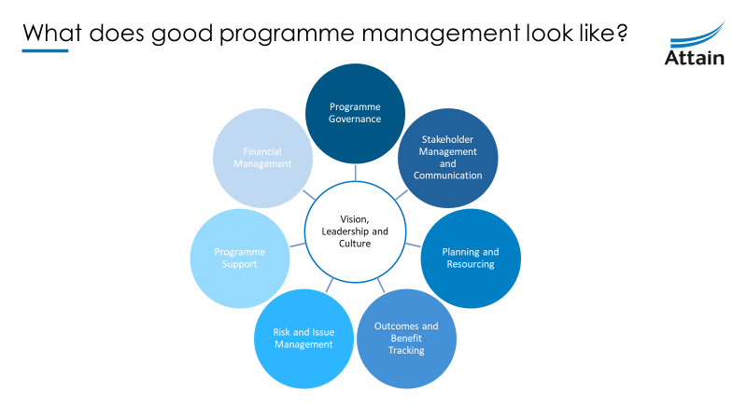
Delivering the initiatives through programme management
In addition to developing the vision, service model pathway, strategy, Attain were asked to review existing regional governance to ensure robust, multi-agency ownership of the ICF Plan, its delivery and evaluation. To begin with Attain highlighted what good programme management looks like (for more detail see appendix 3)
The following slides describe the proposed programme management framework for the Regional Dementia Programme.

Slide 44
Proposed Delivery Approach: Programme Workstream Management
Workstream Planning
Project Execution / Monitoring
Benefits / Value
Projects / Initiatives
Prioritisation
Workstream Management
Workstream Management & Regular Review
Project Management
Planning Cycle / Prioritise
Initiate
Plan
Execute
Close
Resource Management
Processes & Scheduling
Capacity Planning
Assignment
Utilisation of resources
Financial Management
Budgeting / Forecasting
Cost / Benefit Analysis
44

Slide 45
Approach to implementing the Dementia strategy and Wellbeing Pathway
WWCP Dementia Service Transformation Programme
Strategy implementation overseen by strong governance and programme management
Wellbeing, risk reduction, delaying onset, raising awareness and understanding
Increased support when you need it
Recognition, identification support and training
Dementia priorities aligned to workstreams
Stakeholder Engagement
Stakeholder Engagement
Living well with dementia
Assessment and diagnosis
Continuous service improvement underpinned by good data and business intelligence

Slide 46
Proposed workstreams to deliver the WWCP Dementia strategy
WWCP Dementia Service Transformation Programme
Strategy development and implementation overseen by strong governance and programme management
Workstream 1
Programme governance and system enablers
Programme management and culture of working together and sharing best practice
Workstream 4
Dementia
BI and data
Workstream 2 Dementia Service transformation
Stakeholder Engagement
Stakeholder Engagement
Workstream 3
Dementia
workforce development and training
Continuous service improvement underpinned by good data and business intelligence
Period of service transformation is 5 years

Slide 47
Proposed Delivery Approach: Portfolio Management
.
The below indicative set of portfolios will provide structure to deliver the next phase of work developing the dementia strategy/programme plan. The dementia strategy priorities are in line with the All Wales dementia care pathway standards and builds on the current good practice already in place. The dementia priorities should be led by a senior leader within the system and will be overseen by an SRO, along with the WWCP dementia steering group. However, the whole programme of work will also be overseen by the Integrated Executive Group and the Regional Partnership Board. Resources will need to be idenfied over the life of the programme to enable continuation of service delivery while frontline staff work to design and develop the services.
Programme governance and system enablers
Implementation of the regional dementia strategy fully singed up to by the WWCP. Robust achievable implementation plans.
Recruit regional programme manager Regional programme plan developed to deliver the strategy recommendations. WWCP programme governance structure Oversight of 2021/22 projects and allocation for 2022 onwards Enable data intelligence to support decision making and planning Set up and implement the enabling structures stemming from the recommendations within the strategy Communication plan running alongside the strategy, raising awareness, promoting service developments locally
Dementia service transformation
Implement recommendations stemming from the dementia strategy that relate to service transformation.
Proactively supporting people Support regardless of diagnosis Getting the diagnosis pathway and information right first time Supporting those with a learning disability Enabling people to have health reviews and to attend appointments Actions in relation to implementing a system wide response Consistent care while in hospital Maximise the power of MDT working, accessing support when people need it
Workforce development and training
Implement priorities stemming from the dementia strategy that relate to workforce development and training.
BI and data
Implement priorities stemming from the dementia strategy that relate to a uniform approach to collection of business intelligence and outcomes.
Data driving change – develop ICF dementia programme performance dashboard Develop the Dementia wellbeing connector full business case with detailed population needs, workforce and demand and capacity modelling for Dementia wellbeing connector role to provide emotional support throughout the assessment period and over the next 48 hours after receiving a diagnosis Implementation of the dementia strategy recommendations in relation to BI and data.
Aim
Implementation of the Good Work framework – Training for ALL and recommendations in the strategy relating to training e.g. Refresh the West Wales learning needs analysis training framework, work with partners to implement it. Ensuring that all training provided is evidenced based
Development of a workforce plan to support service transformation delivery
Support the development of the dementia recognition tool
Take forward the development and role out of the Dementia wellbeing connector role
Priority Areas
Patient and Carer co-production - improving patient experience through easy access and standardisation of information, services and user/family voice in service change
Co-production, building on and sharing best practice

Slide 48
Proposed Integrated Care Fund (ICF) Dementia Programme Governance Arrangements
Welsh Government
Regional Partnership Board
Regional ICF Forum
Integrated Executive Group
Spend and delivery of ICF Dementia Investment Plan reporting
Dementia Steering Group
Overseeing the development of the ICF Dementia Investment Plan/Regional Programme plan and progress reporting against it and wider implementation of the National dementia Action plan
Regional Health and Social Care Integration Fund Dementia Investment Plan
Programme
Programme governance and system enablers
Dementia service transformation
Workforce development and training
BI and data

Slide 49
8. Next steps for 2022/23

Slide 50
Implementation of the new West Wales Dementia Strategy
Implementing the strategy:
Seek sign off from Integrated Exec Group and Regional Partnership Board, develop communications plan to socialise the strategy so all partners are aware of the direction of travel for dementia services within West Wales.
Communications plan to cover the life of the strategy, enabling the public to be aware of any new developments in their area
Update the programme plan with the new service developments required to deliver the dementia wellbeing pathway
Ensure robust governance is in place to oversee the implementation of the new service initiatives, ensuring all new initiatives take a programme approach reporting progress regularly to the Regional Dementia Steering group
Delivering the programme:
Agree the rationale to continue funding during 2022/23
Identify resource to set up and manage the programme of work across partners - recruit to the role
Create a programme plan, prioritise projects and revise timelines to ensure that there is a realistic and deliverable plan in place. Use Workstream Management as the process for delivery
Identify Workstream SROs to drive work with PMO support; provide ownership and accountability to deliver
Regular progress updates should be provided at the monthly WWCP Dementia Steering Group
Next steps
Notes:
Martin Handover to Jill to close

Slide 51
9. Appendix 1: West Wales Population Analysis

Slide 52
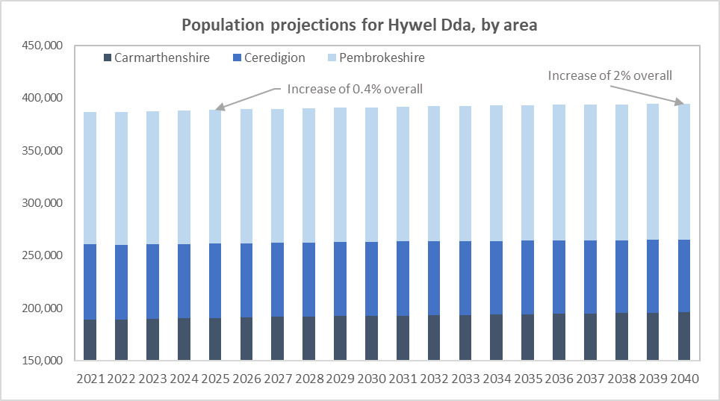
West Wales population analysis (ONS)
Overall the population of West Wales looks like it will increase by 0.4% overall by 2025 and by 2% by 2040 (20 years). Pembrokeshire and Carmarthenshire will see the similar population increases of 0.6% and 0.7% by 2025 and 2.7% and 3.5% by 2040. Ceredigion is expected to have a population decrease (0.7% at 2025 and 3% at 2040). However, in terms of age; all areas are going to see an increase in their elderly populations.
Overall, the elderly population is set to increase, and the child and working age population decrease
By 2025 (in 4-5 years) the population of over 65s is likely to increase by 6% (over 80s by 11%)
By 2040 (roughly 20 years from now) the over 65 population is looking likely to increase by 27% and the over 80s 55%
The over 65s currently make up a quarter of the population. In 5 years around 26.8% and by 2040 it is likely to be nearly a third of the population with the over 80s becoming over 10% (from just over 6% now)
Population projections for West Wales
Source: ONS

Slide 53
West Wales Dementia (QOF Register)
The data in this pack is an extract from the GP systems using the QOF definition.
Women make up approximately 62% of the registered dementia patients in West Wales but this is partly due to higher life expectancy in the female population
Nearly 50% of the female dementia patients are over 85 years old compared to 36% of the male patients. This means that 45% of the total dementia patients over the age of 85 years old. This age group is set to grow substantially over the next 20 years, and is due to make up over 10% of the West Wales population by 2040. Recent studies show that the incidence of dementia is not increasing substantially but due to increased life expectancy and better outcomes for care, perveance will continue to increase.
Mortality from dementia became the leading cause of death in the UK in 2015 and has continued to displace other causes of death. Pre-Covid (2020) it represented 12.7% of deaths and that number had grown yearly
The prevalence across the whole population of patients on the QOF register diagnosed with dementia is just over 0.7%. However, the prevalence in the over 60s (people on the register/population in the age group) is 2.3%. Young onset dementia is defined as those under 65 being diagnosed.
These represent a very small number of GP diagnosed cases but potentially a larger portion of the unmet and undiagnosed need
People over 60 represent around a third of the population and 98.9% of the registered dementia patients in West Wales
Source: GP QOF

Slide 54
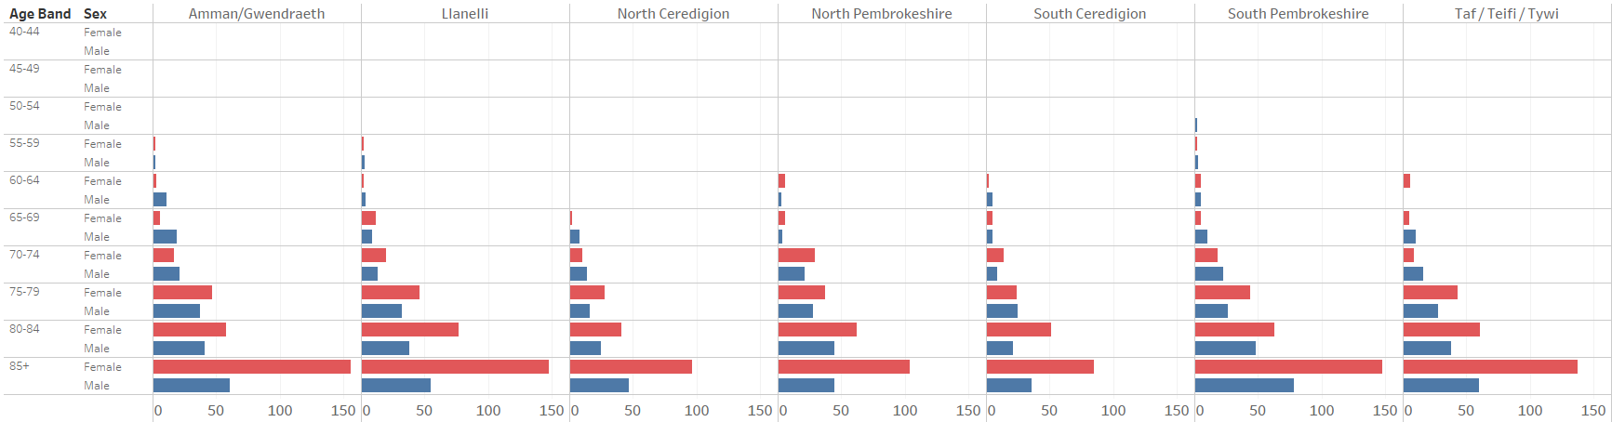
Dementia by cluster
Carmarthenshire has the largest population of the 3 counties across West Wales, it has around 49% of the whole population and 46% over the 0ver 65s, with 24% of its own population over 65 years old. They have 48% of the dementia diagnosis. It is also the most rural area of the three counties.
Pembrokeshire GPs have a recorded population with dementia diagnosis of around 870 patients, which represents around 31% of the dementia diagnosis in West Wales. As a county they have 32.5% of the population and 34% of the over 65 population. The over 65 population represents nearly 27% of the total population in Pembrokeshire. However, by 2040 the growth for Pembrokeshire will be 6.6%
Although Ceredigion’s population is set to decrease overall, the over 65s is set to increase by over 4% in the next 20 years.
The below graphic shows the male and female actual numbers by cluster and as you can see, the three Carmarthenshire clusters have very high numbers, comparatively, in the female over 85s category. Notably South Pembrokeshire also has high numbers of both male and female over 85s diagnosed with dementia
Source: GP QOF and ONS

Slide 55
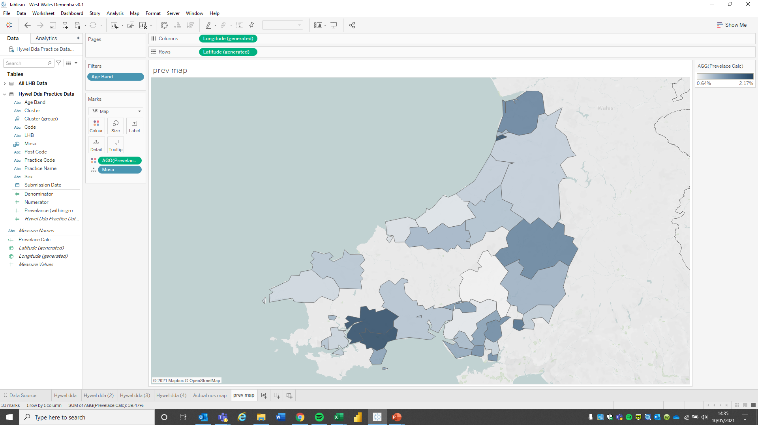
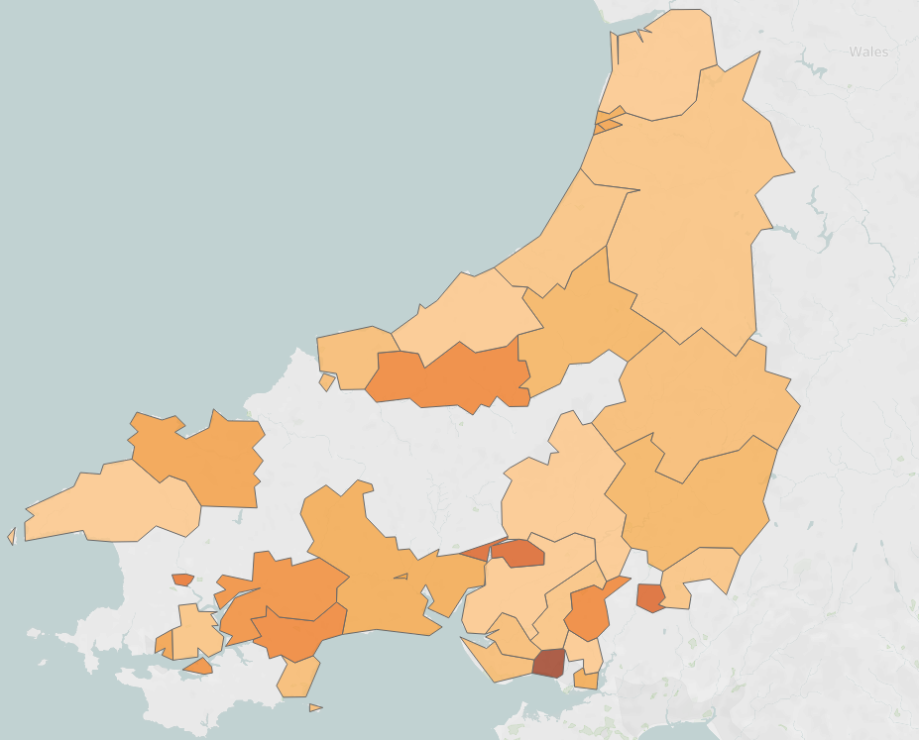
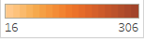
Map
Lower Layer Super Output Areas (LOSA) data for patients was not available and so the below information shows the pressure for the GP practices at a Middle Layer Super Output Area (MOSA) level which is why there are gaps.
Proportion of over 40s population based on practice list, by MOSA of practice location
Total diagnoses population based on practice list, by MOSA of practice location

Slide 56
Dementia- prevalence
The chart below shows the current registered dementia population and the possible undiagnosed level; it then predicts, based on both the undiagnosed rate and population growth, the possible number of patients living with dementia across West Wales by 2040. It is important to note that the impact of COVID-19 on the diagnosis and incidence rate of dementia is still unknown. There is concern that, in some cases, COVID-19 causes damage to the brain and long term this could lead to increased risk of developing dementia*
Population West Wales
Current estimated dementia patients
2040 estimate
Population 386k
7,900 (includes undiagnosed need)
2,812
5,300
= On GP register
Dementia
= Estimated undiagnosed
2,488
Prevalence on the GP registers is currently just under 1% overall
There is a likely diagnosis gap of around 50%
The above calculates, at a high level, the possible actual prevalence based on population growth and application of the diagnosis rate
The prevalence as a rate could be as high as 2% by 2040, based on the growth in the over 65 population
To put this into perspective…
This is equivalent to everyone in Pembroke living with dementia.
*Reference: “The chronic neuropsychiatric sequelae of COVID-19: The need for a prospective study of viral impact on brain functioning” - Gabriel A. de Erausquin et al

Slide 57
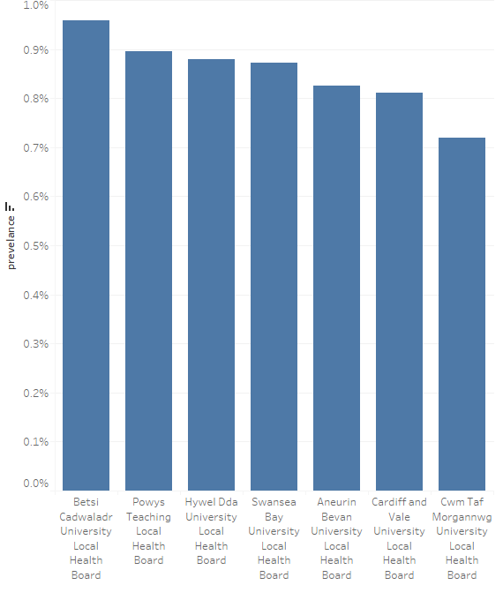
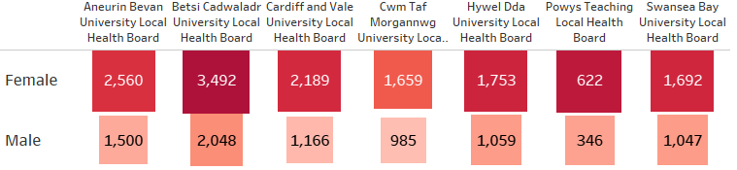
Health board comparison
The graph to the right shows the prevalence rates for dementia recorded in the GP registers (according to QOF definitions). Note, this is likely to be a lower than actual prevalence rate due to using GP registered population from the GP system as the denominator (and not resident population, it also includes all age groups)
However, the important thing to note is the differences rather than the numbers. West Wales are the 3rd highest and they are slightly above the Wales average (circa 0.87% compared to 0.85%)
Dementia GP register prevalence (among adult population)
Numbers of patients on dementia register by sex and UHB

Slide 58
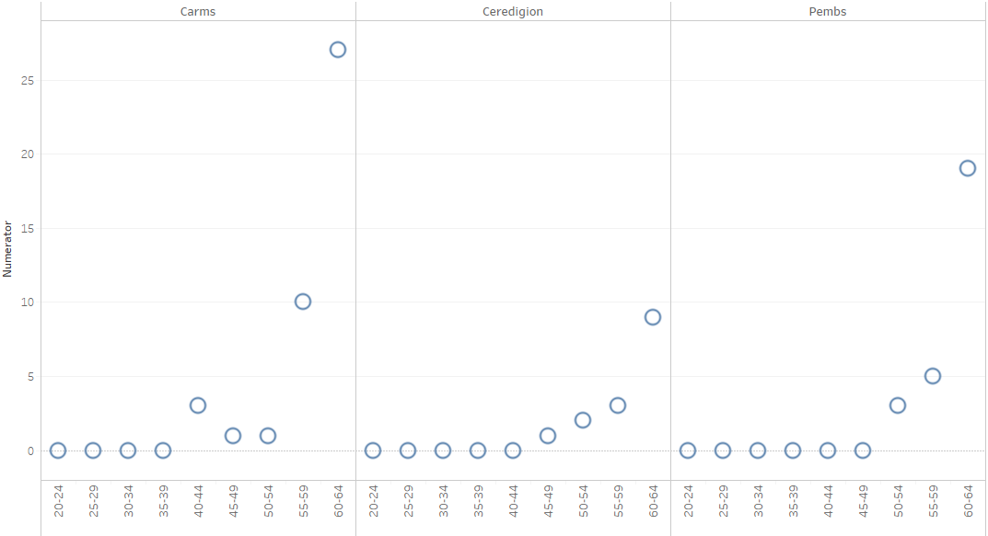
Young onset
Young onset dementia is the onset of dementia when a person is under 65 years old. Across West Wales there are 84 patients on the registers who are under 65 years old. Of those, 55 are in the 60-65 year age group. This gives West Wales a rate of 0.04% across the population in the adult population, which is very similar to the rate seen across Wales registers nationally.
There are 5 patients on the GP registers who are under 50 years old. There are under 30 in Wales as a whole (with a formal, GP registered diagnosis). Again, the prevalence rates across West Wales are higher than that of Wales (around 0.0025%)
Young Onset Dementia by age and cluster

Slide 59
10. Appendix 2: Feedback From Initial Structured Interviews

Slide 60
Stakeholder Engagement
Many thanks to those who engaged in this first phase of work:
Name | Title | Additional Staff
Rhian Dawson | Hywel Dda UHB & Carmarthenshire County Council - County Director Carmarthenshire | Emails sent 25/03 and 12/04
Jina Hawkes | Hywel Dda Health Board - General Manager Community Primary Care - Ceredigion
Sonia Hay | Hywel Dda UHB - General Manager Community & Primary Care -Pembrokeshire | Charlotte Duhig, Ceri Griffiths plus 2 others
Rebecca Jones | WWCP Programme Manager for Workforce development
Sue Leonard | CEO PAVS | Cherry Evans Sophie Buckley
Elaine Lorton | Hywel Dda UHB County Director Pembrokeshire
Peter Skitt | Hywel Dda UHB - County Director Ceredigion
Alex Williams | Head of Integrated services Carms | Plus Carms colleagues
Neil Mason | Hywel Dda UHB - Service Manager Older Adults Mental Health | Plus Admiral Nurse
Graham O’Connor | (Hywel Dda UHB - Consultant Psychiatrist)
Donna Pritchard | Head of Adults Ceredigion Council | Ellen James, Sian Howys, Nerys Lewis
Claire Sims | Hywel Dda UHB - Head of Occupational Therapy | Plus Karen Shearsmith-Farthing
Becca Stilwell | Clinical Psychologist | Email sent 15/04/21
The first phase of the development of this strategy took place January through to May 2021. Attain were initially commissioned by Carmarthenshire County Council on behalf of the WWCP to carry out a review of the ICF Dementia Investment Plan along side the development of a high – level dementia strategy vision and service model pathway across the West Wales region. The initial work was well supported by WWCP who worked with Attain to codesign a high-level draft dementia strategy. Stakeholders from across the region worked very hard to provide local knowledge and insight, through structured stakeholder discussions. The themes stemming from the initial interviews have been summarised where possible on the following pages. Theme form the second phase of work is summarised earlier on in the strategy.
60

Slide 61
The themes stemming from the interviews with stakeholders have influenced the development of the service model pathway and the recommendations within this report.
Main themes
What works Well
What could be
improved
What elements
are missing
Joined up services
A clear regional strategy, vision and service model is needed and long term funding to deliver the services is needed
3rd sector dementia connector role has brought together other dementia focused roles now operating as an MDT
Consultants trained to be able to support people with dementia
Informal carers getting exhausted - could be prevented if they have the right support
Dementia is so wide - it is across the whole community and it really needs to be part of day to day planning and development
The overarching thing not addressed is base line wrap around the person, a co-ordinator throughout their journey
New Admiral Nurse service sitting with social care - providing support, bringing other professionals in team around the person
There is a need for all GPs to take the responsibly for onward prescribing of dementia
No centralised overview of GP dementia registers
Organisations now need to play their part to form a joined up integrated approach - not easy for West Wales
There is no coherent pathway and a lack of person centred care/understanding of dementia
Some good examples – Delta Connect, fulfilled lives - person centred domiciliary care, Ceredigion - come up with good solutions - real team feel
GPs/AHPs could be making straight forward diagnosis. MH team should be focusing on specialist diagnosis
Programme management of West Wales dementia services through the WWCP, service evaluation and performance reporting
Lots of handovers between services - difficulty with the long term care - where does dementia sit? No one service has the capacity to manage this large cohort
Alzheimer's provide pre-diagnostic support following referral - people go directly to face to face support rather than a call centre.
National system feedback on hospital care can be adapted for PLWD and their carers to provide feedback on all our services
Requirement to have EoL conversations earlier. Some professionals reluctant to enter in ACP conversations
The service vision and model needs to ensure that services are easy to access and joined up
Attribution that dementia is a MH issue so if someone presents with challenging behaviour they call MH

Slide 62
The themes stemming from the interviews with stakeholders have influenced the development of the service model pathway and the recommendations within this report.
How people are diagnosed
How people access services
Workforce and Training
Use of technology
Communication
Dementia wellbeing in the acute hospitals supporting reasonable adjustments for those admitted. Part of the ward MDT – about to be evaluated
Local Authority carers assessment is not dependant on a diagnosis but you still hear of it
Social care domiciliary care, respite care - harder to access and less secure postcode lottery going on to access
The regional dementia wellbeing team about to be launched will provide training to upskill staff and a specialist MDT approach for complex cases
In alignment with best practice, the use of technology should be central to the delivery of dementia services
Currently too many handoffs not joined up in anyway - need to have some co-ordination and case management.
Need for earlier identification and diagnosis in primary care. Need to fast track dementia diagnosis in line with CHC assessments
Where do people lives sit? Holistic picture - need to include the needs of the carers collated within the record of the person living with dementia.
People providing care need to be able to spot dementia and have skills to support - regular training refreshers are needed
Delta connect trying develop care so the person can stay at home
Develop structure for services to communicate better with each other/to share information - what is available in the community - feels very fragmented.
Consider what is the purpose of the diagnosis? Treatment? Medication? Delaying the inevitable? Respite, carers support?
There is an opportunity for a central point of access through the Delta Wellbeing service which is provided regionally
GPs require training to detect the early signs of dementia and physical issues in the advanced stages. Trainee MH nurses need training in dementia
The Wellbeing Team is working with Delta connect - trying to skill up the crisis team to stop people having to go into hospital
FIRST OF ITS KIND - OT’s are working in Scotland and are providing journey through dementia - protocol led interventions which will be evaluated
Belief that it can only take place in MAS setting - some patients get diagnosed in hospital. Need an MDT approach to diagnose in community
Need to review dementia navigators, community commentors, social prescribing type roles to avoid duplication and align them across the system
A lack of knowledge, confidence and skill in staff/services recognising that people with dementia and their carers use multiple services
The Wellbeing team is working with @learning Wales to make the training more accessible. Mindful that eLearning training doesn't give people tools

Slide 63
11. Appendix 3: Approach to managing the programme of work
Project Requirement | Progress | Key Accomplishment
Review existing regional governance to ensure robust, multi-agency ownership of the ICF Plan, its delivery and evaluation |  | This report provides a suggested programme outline

Slide 64
What does good programme management look like?
Vision, Leadership and Culture
Programme Governance
Stakeholder Management and Communication
Programme Support
Financial Management
Planning and Resourcing
Outcomes and Benefit Tracking
Risk and Issue Management

Slide 65
The components of a good programme (1)
 | Vision, Leadership & Culture | Programme Governance | Stakeholder Management and Communication | Planning and resourcing
What good looks like | Clear shared vision owned by all partners Joined up leadership fully engaged Vision and strategy are aligned with partners’ organisational strategies and relevant regional / national strategies | Clear governance structure in place that includes input at the right level for decision making and managing risks/issues Clear process in place for escalating risks, issues and opportunities Lean structure; time is used effectively, with a balance between discussion and action Programme team have a clear understanding of roles and responsibilities Patient / public engagement embedded in programme governance Clinical leadership embedded in programme governance | Stakeholder mapping and communications plans in place Key stakeholder relationships are managed proactively External communications are targeted at relevant audiences and accessible language / communication formats are used Internal communications to keep programme team informed, support team dynamics Successes are celebrated internally and all areas of the programme contribute to case studies and good news stories for external use | Robust overall business case for the programme in place and agreed by partners, with review points in place to establish ongoing viability Each workstream has a clear plan, setting out what will be delivered, how and when Interdependencies have been mapped Resources required to deliver the programme have been mapped and investment agreed OD requirements mapped and strategy in place for coordinated delivery
Tools and products | Vision / mission / values statement Memorandum of Understanding / partnership agreement Outline Business Case | Programme Governance Structure Chart(s) Terms of Reference Meetings forward plan Programme team organisation chart Roles / responsibilities matrix Reporting and risk/issue escalation processes Templates for meeting agendas, notes and actions, highlight reports | Programme Communications & Engagement Strategy / Action Plan Stakeholder mapping tool Internal communications process Equality Impact Assessment process and documentation Core set of programme documentation / presentations / branded templates for use with a range of audiences Engagement tracker | High level programme plan with milestones and critical dependencies Detailed programme plan PMO work plan Recruitment and resourcing tracker (programme team) Business case process, template and guidance Financial plan

Slide 66
The components of a good programme (2)
 | Outcomes and Benefit Tracking | Risk and Management | Programme Support | Financial Management
What good looks like | Financial and non-financial benefits of the programme have been clearly articulated (covering activity shift, clinical quality and patient experience) and tested out with key stakeholders Robust methodology in place to track benefits across all work streams Baseline data captured Outcome measures are targeted to enable monitoring of specific interventions – to see whether a change is effective Existing data sets and reporting are utilised wherever possible to minimise reporting burden (lean approach) | Key risks to delivery of the programme have been mapped and mitigating actions identified Clear processes are in place for identifying and tracking risks, with levels of escalation Robust, consistent documentation used across the programme to support proactive risk management and provide an audit trail Programme risk register is maintained and reviewed regularly with evidence of following up mitigating actions recorded and followed through | Information is well managed and easy to find, e.g. contact list, filing structure, protocols in place for maintaining an audit trail Change control in place for core documents/tools PMO team is able to support operational staff / work streams by reducing the documentation burden PMO advises and supports programme team / delivery leads; skills development, quality improvement Quality assurance is in place for key deliverables | Budget agreed for programme resourcing Robust mechanisms in place for management of programme budget – budget setting, change control, monitoring, accounts payable, procurement
Tools and products | Business Case/ Investment Appraisal Benefits/outcomes framework, capturing key performance indicators, outcome measures, metrics etc) Benefits realisation plan and tracking tool | Programme risk and issue register Risk management process and guidance | Programme contact list Information Management protocols and filing structure Shared programme calendar / inbox | Programme Financial management process / control Programme budget

Slide 67
Proposed Delivery Approach: Programme Workstream Management
Workstream Planning
Project Execution / Monitoring
Benefits / Value
Projects / Initiatives
Prioritisation
Workstream Management
Workstream Management & Regular Review
Project Management
Planning Cycle / Prioritise
Initiate
Plan
Execute
Close
Resource Management
Processes & Scheduling
Capacity Planning
Assignment
Utilisation of resources
Financial Management
Budgeting / Forecasting
Cost / Benefit Analysis
67

Slide 68
Contacts
Martin Wilson martin.wilson@attain.co.uk 07710 744391
Su Gordon-Graham su.gordon-graham@attain.co.uk 07717 035647
Adele Yemm adele.yemm@attain.co.uk 07766 681051
Cherie Cope cherie.cope@Attain.co.uk 07787 427341
Notes:
Martin

