Slide 1




Integrated Care Fund Challenge Session
Clinical Health Psychology in Integrated Care Services
Long Term Conditions & Frailty

Slide 2
Service Overview
  Access to psychological help for people with long term physical health problems whose self-management and independence are compromised due to psychological difficulties
  Pathway development : Referral System
  Tiered model of care
  Enhance wellbeing & Provide early intervention to prevent deterioration

Slide 3
Project tie-in with ICF objectives
Integration
Provides Integrated & Collaborated Approach for Older People with Complex Needs and Long Term Conditions

Slide 4
ICF Objectives
Prevention & Early Intervention
Prevent escalation of mental health difficulties which compromise management of physical health & independence & increases risk to admission
Early intervention by existing professionals involved in care

Slide 5
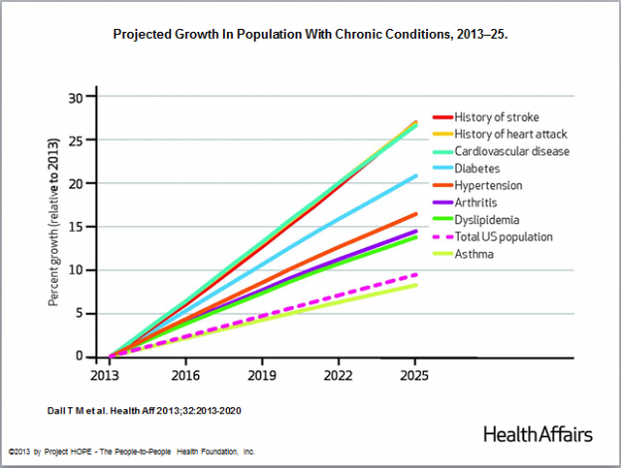

Slide 6
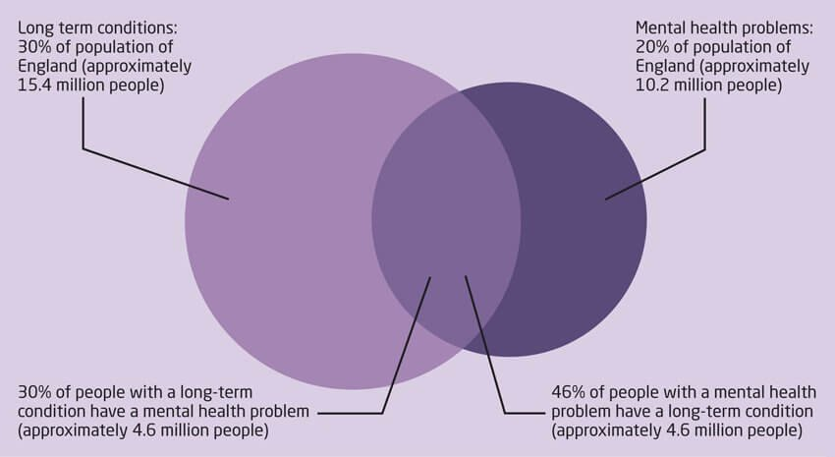
Population

Slide 7
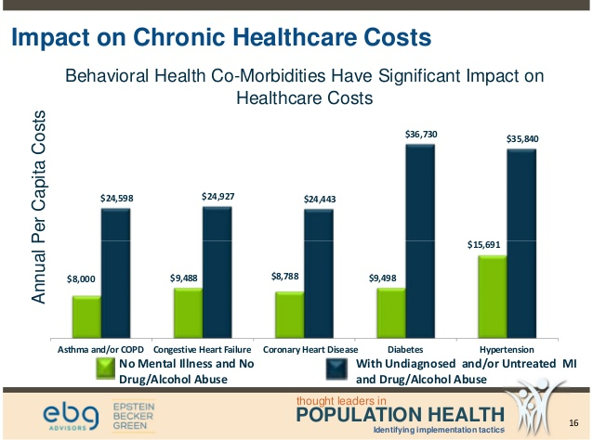

Slide 8

Co-morbidity Increases Health Care
Costs Significantly
  by at least 45% for each person
  depression increases annual costs by £1.5k per person (minimum)
  In terms of NHS spending, at least £1 in every £8 spent on long-term conditions is linked to poor mental health and wellbeing – between £8 billion and £13 billion in England each year.

Slide 9

Poorer outcomes & Prognosis
CVD patients with depression experience 50% more acute exacerbations per year & have higher mortality rates
Depression increases risk of mortality after heart attack by 3.5 times
COPD: worse breathlessness, health status & prognosis in COPD
Asthma: Depression doubles the mortality rate

Slide 10

Poorer outcomes & Prognosis
2 -3 times more likely develop depression
Co-morbidity :38% increased risk of mortality
Poorer glycaemic control & medication adherence
More diabetic complications (e.g. retinopathy, neuropathy, amputation)
overall costs are 400% more
10% of NHS hospital expenditure

Slide 11
Effects of Co-morbid Psychological Difficulties with Chronic Conditions
Reduced wellbeing
Poorer self-management
Increased use of healthcare resources
Worse Prognosis & Increased morbidity
Reduced Quality of Life
Increased costs to services

Slide 12
Clinical Health Psychology Service Model
Clinical Health Psychology
LTC
Health and Social Care Workforce (LTC)
Epidemiology
Resp/Card/Diabetes & CRT complex cases
Psychological interventions
Training
Case consultation
MDT
Presentations
Deliver low intensity psychological interventions
Early intervention and prevention of escalation
Increase awareness of impact of psychological difficulties / Prevention & wellbeing

Slide 13
Reasons for Referral
Depression
Anxiety
Post Traumatic Stress
Anger
Acceptance Difficulties
Eating Disorders
Poor self management
Carer distress
Uncertainties around cognitive difficulties or capacity
Other mental health difficulties affecting physical health management
Needle Phobias
Intolerant CPAPS
Adjustment
Disengagement
Poor insulin adherence
Hopelessness
Dependency
High use of service – anxiety
Poor adherence

Slide 14
Staffing Structure
Clinical Health Psychology Lead
North Ceredigion
Clinical Psychologist
1.0 wte
IMTP
South Ceredigion Clinical Psychologist
1.0wte
IMTP
Llanelli & Amman Gwend
0.8 wte
IMTP
Llanelli & Amman Gwend
0.6 wte
ICF
Carmarthen 2 T’s
0.8 wte
ICF

Slide 15
Funding arrangements
Funding arrangements:
Budget: | £70,928
Funding from ICF: | £70,928
Any other funding: | none
Spend 2017/18 (incl spend to date): | £45,355
Projected 2019/20 budget required: | £70,928

Slide 16
Performance

Slide 18
Notes:
Total 887

Slide 22
Waiting List
Ceredigion : 8+ weeks (currently 17 waiting)
Llanelli: 8+ weeks (currently 10 waiting)
Carmarthen: 12+ weeks (currently 30 waiting)

Slide 23
Activities
Clinics
Home visits
Cardiac Rehabilitation Group – Heart failure
CRT Staff Consultation & Direct Patient Work
Various MDT
Frequent Callers
Training
Presentations

Slide 24
Activity: Clinics/Patient slots
 | Clinics per week | Patient slots per week
Llanelli & Amman/G | 7 | 21
Carmarthen | 4 | 12
Ceredigion | 6 | 18
Total | 17 | 51

Slide 25
Activity Training: NICE Guidance CG 91
Step | Severity | Intervention
4 | Severe and complex depression; risk to life; severe self neglect | High-intensity psychological work; Medication; ECT; Crisis service; possible inpatient care
3 | Persistent mild-moderate depression with inadequate response to previous intervention; moderate and severe depression | High-intensity psychological work; Medication; collaborative care; further assessment and intervention
2 | Persistent sub-threshold depressive symptoms; mild to moderate depression | Low intensity psychological interventions; medication; further assessment and intervention
1 | All known and suspected presentations of depression | Assessment, support, psycho-education; active monitoring;
Notes:
NICE present a stepped care approach to managing depression in LTC.
The principle underpinning the model is that the least intrusive intervention is provided first and if the patient does not benefit from that intervention, then consider offering an intervention in the next step. Although the guidelines have been developed specifically around depression, we can use the same principle to approach other psychological difficulties also, including anxiety, difficulties with adjusting or coping and loss.
This training package aims to support the delivery of Steps 1 and 2, which are highlighted in green here.
Step 1 which we will cover this morning/today refers to the recognition, assessment & initial management of depression in primary care
Step 2, will be looked at this afternoon/at a later date, with a specific focus on low level psychosocial interventions, such as behavioural activation and problem solving.
Medication gets mentioned in step 2 – but according to NICE it should not be used routinely to manage subthreshold or mild depression in patients with LTC because the risk to benefit ratio is poor. There are some exceptions, such as previous history of moderate/severe depression or if depression persists after other interventions.
There are a number of reasons for us to be offering this training and some of our goals include:
To increase psychological mindedness and skill in the physical health setting – (that is, the ability to think more psychologically about people; to reflect on own and other’s behaviour; to bring an additional line of thinking to your work,)
To develop people’s skills in recognition, assessment, and management of depression and anxiety
To enhance psychological skills of the health workforce and to support colleagues
All of which serves to improve the emotional and physical wellbeing of people with long term conditions.

Slide 26
Training Activity
Step 1: Assessment Workshops : 15
“Recognising Common Mental Health Problems in Long Term Conditions”
Step 2: Treatment Workshops : 12
“Low Intensity Psychosocial Interventions for Depression and Anxiety in Long Term Conditions”
Motivational Interviewing Workshops: 2

Slide 27
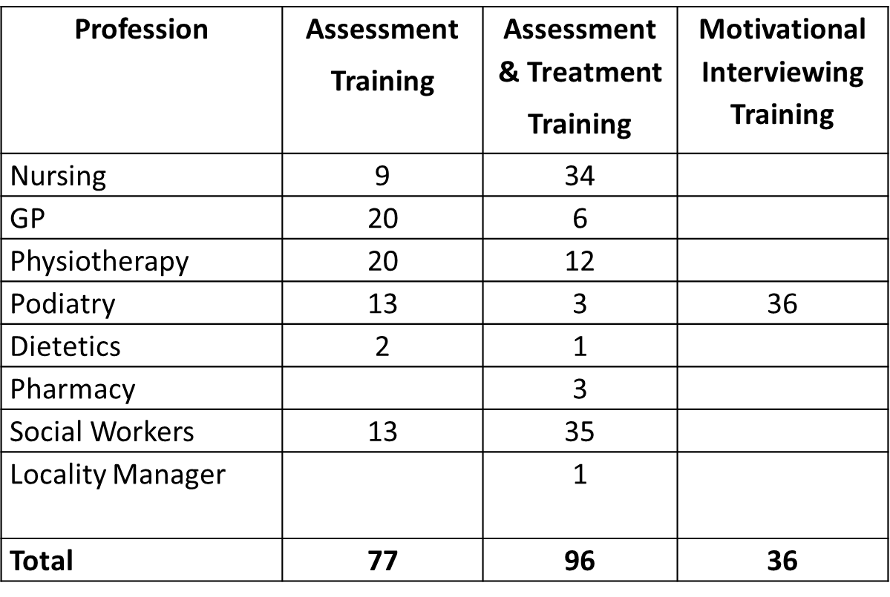
Professional Groups

Slide 28
Teaching & Presentations
Aberystwyth University Diabetes Conference
Diabetes Update Day
M.Sc Nursing – Diabetes Module
B.Sc Diabetes Nursing
All Wales Oxygen Network Study Day
Patient Forums (Diabetes UK)
Age Concern
A & E and Outpatients Bronglais Hospital

Slide 29
Key Achievements & Outcomes

Slide 32
Value for Money
Depression increases healthcare costs by minimum of £1.5k Per annum, per patient
Our Outcomes 221 patients have improved depression at discharge
= Reduced costs of £331, 500 per year (minimum)

Slide 33
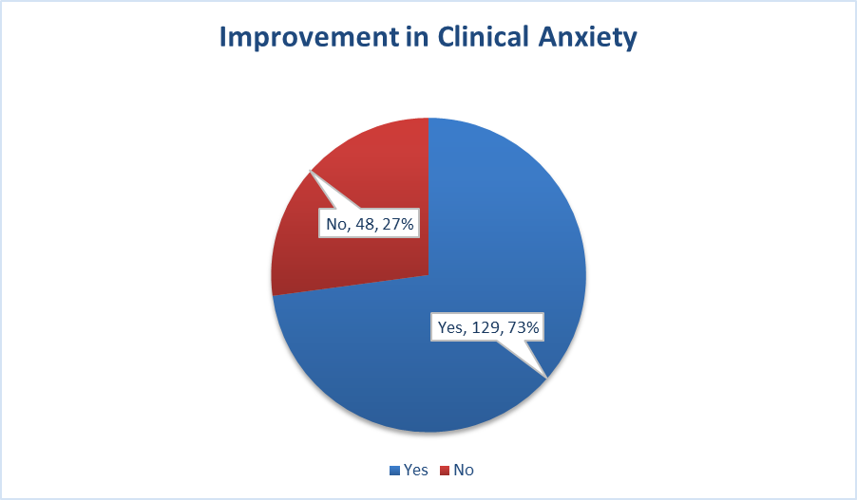
Clinical Anxiety n=177
Notes:
177 met clinical anxiety levels. Data shows levels of clinical anxiety at point of discharge

Slide 34

Poor Wellbeing n=277

Slide 35
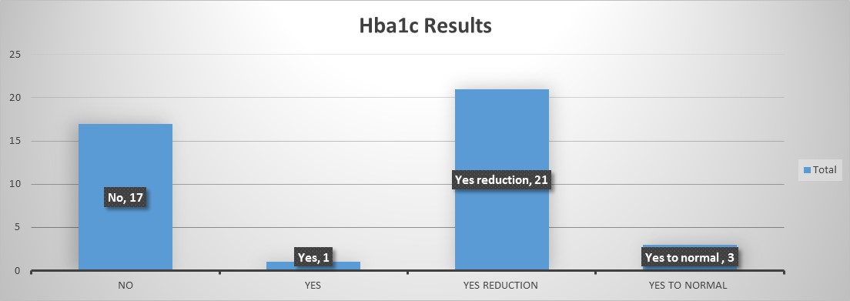
Notes:
Total of those with elevated Hba1c . 8 month data. From April 2018

Slide 36
Performance Indicators
Feedback

Slide 37
Patient Evaluation : Questionnaire n = 68
Strongly Agree Agree Neutral Disagree Strongly Disagree
1. I am satisfied with the Psychology service
2. We focused on matters that were important to me
3. My ability to manage my emotional wellbeing has improved
4. My ability to manage my physical health has improved
5. If my friend or family needed this sort of help I would suggest this service
6. How would you rate the service overall
Notes:
Excellent Good Fair Poor Very Poor

Slide 44

Please use this space to add any further comments you may wish to share:
“The psychology service certainly helped me through a most frightening episode and recovery process. Felt I could say exactly how I felt each session which was difficult with friends and family as have always been the level, dependable one. I have changed. Thanks.”

Slide 45
“Helped to put me back on my feet again”
“It has been a great help to be able to voice my problems to someone. You don't always want to burden your family with negative thoughts”
“Made me 'think' instead of writing myself off! When in permanent pain, its difficult to look at things logically. It was a great help.”
I feel like a different person altogether. I can deal with things a lot better than when I first came to see you I am relax now. I feel happier & relaxed

Slide 46
Staff Feedback : Specialist Diabetes Nurse
“ The psychology service has improved patient outcomes, patients feel supported emotionally as well as practically. Diagnosis of Diabetes be it Type 1 or Type 2 can be devastating for patients and they know its something they have to live with for life. The impact on their work/family can be difficult, that is without dealing with their own feelings. Recently I had a Type 1 who I had been looking after for sometime, his glycaemic control was sub standard and he wasn’t engaging with our service. I referred this chap to the psychology service and after a few months, he now tests regularly, regularly gives his insulin and has recently attended an education course. In his words “it has changed his life and he feels better equipped to manage his diabetes on a day to day basis”. This service has been a welcome addition to our existing diabetes service and we are not sure how we managed previously.”

Slide 47
Key case study / studies

Slide 48
CRT Referrals: Case Examples
Reason for Referral | Outcomes
Crisis Residential Placement Crisis: High input SW | 1:1 work overcoming change. Placement needs reviewed. Reduced SW input
Complex neurological condition: not engaging with physiotherapy | Systemic work with client & family & carers. Care package reduced from 3 calls to 0 (none).
Risk of admission. Unwilling to allow District Nursing in house to address leg ulcers | 1:1 addressing fears & beliefs. Capacity assessment. Px gave access to District nursing. Admission avoided
Trauma suspected. Carer burn-out | PTSD Dx & Tx. Reduced carer burden & risk to care arrangement. Long term care avoided.
Wife/Carer opposing views to SW: wanting long term residential care | 1:1 with Mrs. J. Carer burden focus. Agreed respite option. No need for LT care package
Complex case high care package; Burnout & high turnaround SW | Education on Neurological condition provided. Care reduced from 2 to 1 calls per day
Poor recovery following fall. | PTSD Tx. Distress reduced. Reduced input from CRT
Paranoid ideation. Risk breakdown care package. High level input SW | CBT for delusional beliefs undertaken. Management strategies relayed to carers. Referral to psychiatry
High input from SW –depr/pain/acceptance issues | 1:1 for Chronic Pain management, QoL. Less SW input

Slide 49
Case Study 1: Mrs S
70yrs old . Lived alone. GP referral Deteriorating health past 3 years “she has become quite depressed”
Hx. Admission with Pituitary adenoma. Nerve palsy = loss of sight in one eye. Type 2 diabetes. Hypertension
GP referral “ “she links her low mood to her decline in physical health… needs… “help her come to terms with her changed circumstances in relation to her physical health”.

Slide 50
Assessment
not coping with co-morbid long term conditions (“this is the end for me”, “I’m no good”)
developed clinical depression & clinical levels of anxiety
Her personality had changed, more intolerant, agitated, frustrated
She reported feeling low, anxious and frustrated when she could not do all that she wanted and felt quite angry.

Slide 51
Mrs S: Psychological Intervention 3 x 1hr
Development psychological formulation of her difficulties
Acceptance & Commitment Therapy” (ACT)
Cognitive techniques (CBT) were used to help her re-evaluate her thinking
Emotional resilience enhancement techniques were introduced including mindfulness.

Slide 52
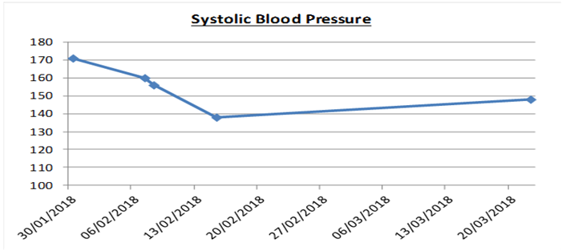
Mrs S: Results
DEPRESSION
Assessment | Discharge
Severe | Severe
Moderate | Moderate
Mild | Mild
Normal | Normal
ANXIETY
Assessment | Discharge
Severe | Severe
Moderate | Moderate
Mild | Mild
Normal | Normal

Slide 53
Mrs S Reported
“ psychology had been very beneficial”
“family & friends had been commenting on a noticeable difference in her, being calmer and less irritable
“she has noticed a change in her reactions and approach to things. She is more accepting of her capabilities and limits and is able to ‘give herself a break”
Questionnaire – strongly agree noted for all items & rated service as excellent
“Very pleased with my progress. Helped me such a lot in my wellbeing. Was so easy to talk of my feelings”

Slide 54
Case Study 2 : Mr T
Functional Neurological Disorder : frailty, lower limb weakness, memory loss, walking with aid of stick, not leaving house much, low mood, withdrawn from family & friends
Carers calls x3 daily + mother visited daily
Chronic mental health difficulties
Referred by CRT Physiotherapy – reached a plateaux & suspected lack of progress was psychologically based: increased reliance on carers

Slide 55
Case study 2: Mr T
2 assessment sessions with Mr.T, mother & auntie
2 individual therapy sessions
1 joint working session with social worker & physiotherapist
Psychological Understanding: current care was maintaining FND presentation & limiting opportunity to be independent, reducing mood & physical condition
Goal setting developed to build Mr.T’s confidence & others to “let go”
OT referral for specific skill development in the kitchen
Reduce carer calls from 3 to 0 visits
Reduced costs & improved wellbeing

Slide 56
Value for Money
Reduced depression rates alone estimated £250K saved with the ICF investment
Social care/CRT/ reduced care package costs following input too
As co-morbidity increase costs by 45%, improvements in co-morbidity will reduce these costs
Decreased pressure on services as self-management improves (e.g. podiatry, specialist community services etc.)
Reduces risks of admission through improved management (e.g. use of CPAPS machine therefore reduce risk of exacerbation)

Slide 57
Sustainability plan
Continued ICF Funding Required until alternative funding streams become available
Long Term Exit strategy:
Included within IMTP for core funding (funding stream not currently available)
Implications if funding ceased :
2 posts on Permanent contracts – risk of overspend of £70k for Health Board/ Carms County

Slide 58
Project development
Increase capacity as currently unable to meet demands
Open service to wider population group with long term health needs (e.g. gastro, renal, endocrinology, haematology, post sepsis, frailty clinic etc.)
More reactive service for urgent CRT/SW cases
Roll out cardiac rehab group for heart failure within Carmarthenshire
Development of primary care work & prevention (MDT; clinics at GP practices)
Follow-up training – supervision & refreshers
Integrate with partners within the 3rd sector
Deliver low level preventative work in the community for older adults (e.g. living well groups/ beating the blues groups/ mindfulness groups)
Integration with Social Prescribers with barriers to engagement (behaviour activation/behaviour change/motivation etc. )

Slide 59
Conclusion
There is a demand for psychological services for long term conditions and people with complex needs
Current capacity does not meet demand
Psychological service has demonstrated efficacy and value for money
LTC population growth projected to increase dramatically over next decades – need will be even greater
Training others to deliver psychological work has been positively received & provides a sustainable solution to the challenge
Continued investment is required as planning for core funding continues

Slide 60

“Mental health problems can complicate people's physical health conditions greatly, resulting in them spending more time in hospital, experiencing poorer clinical outcomes and lower quality of life, and requiring more intensive support from services”
Notes:
There are also wider implications for how we care for the growing number of people with long-term conditions. Internationally, the prevailing approach to this is to attempt to reduce demands on formal care by supporting patients to manage their own condition effectively. But attempting this without recognising the effect of co-existing mental health problems is a recipe for failure.
Left untreated, mental health problems can significantly reduce the motivation and energy needed for self-management, and lead to poorer adherence to treatment plans among people with diabetes, cardiovascular disease and other long-term conditions. This goes a long way towards explaining why this group experience poorer physical health outcomes, as well as greater service costs.”

